Slide 1
Forward Looking Extreme Weather Datasets 26-May 2024
Casey Burleyson, Cameron Bracken, Kostas Oikonomou, and Nathalie Voisin
PNNL-SA-196351
https://godeeep.pnnl.gov/
Notes:
- Thanks for the opportunity to share the work we’ve been doing
- My name is Casey Burleyson and I’m a meteorologist working at PNNL. I study climate and weather impacts on the grid.
- I’m here representing a great team of PNNL scientists, notably Nathalie Voisin, Cameron Bracken, and Kostas Oikonomou who are my co-authors, who have been working to understand and project climate impacts on the grid.
- Will present work from multiple projects but the main effort is from PNNL’s GODEEEP initiative which is bringing together grid, climate, and social scientists to study the resilience and reliability of a decarbonized grid

Slide 2
Assertions
The existing grid is weather sensitive.
Weather characteristics (e.g., extremes) are changing rapidly.
The grid is also changing rapidly.
A high renewables grid will be even more weather sensitive.
Credit: NASA's Scientific Visualization Studio

Slide 3
Key Messages
To assess the resilience and reliability of the bulk power system, it is critical to evaluate system performance:
With coincident load-wind-solar-hydro conditions;
Across a wide range of historical and projected weather conditions.

Slide 4
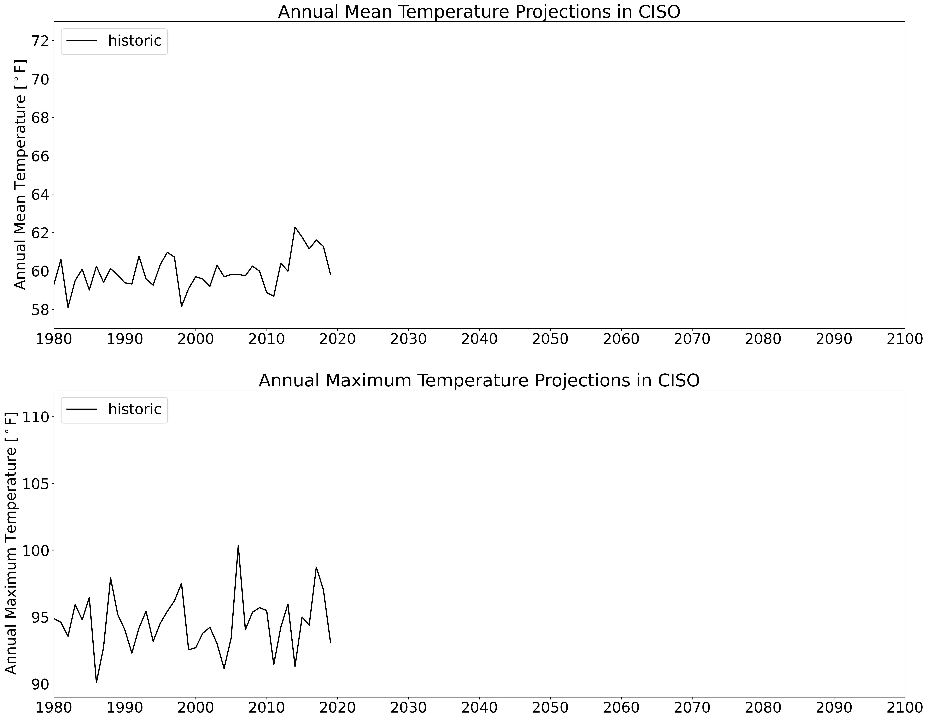
U.S. Climate Projection Dataset
Historic data reproduces observed sequence of past events (1980–2019)
Sequence is repeated twice in the future (2020–2059 and 2060–2099) with additional warming gradually applied
1/8 deg (~12 km) resolution, U.S., hourly
25 hourly and 250+ three-hourly variables
Output is first spatially-averaged by county then population-weighted to create annual 8,760-hr meteorology time series for 54 BAs across the U.S.
Hot Year
Climate data was developed with DOE Sc funding and is publicly available: https://data.msdlive.org/records/cnsy6-0y610

Slide 5
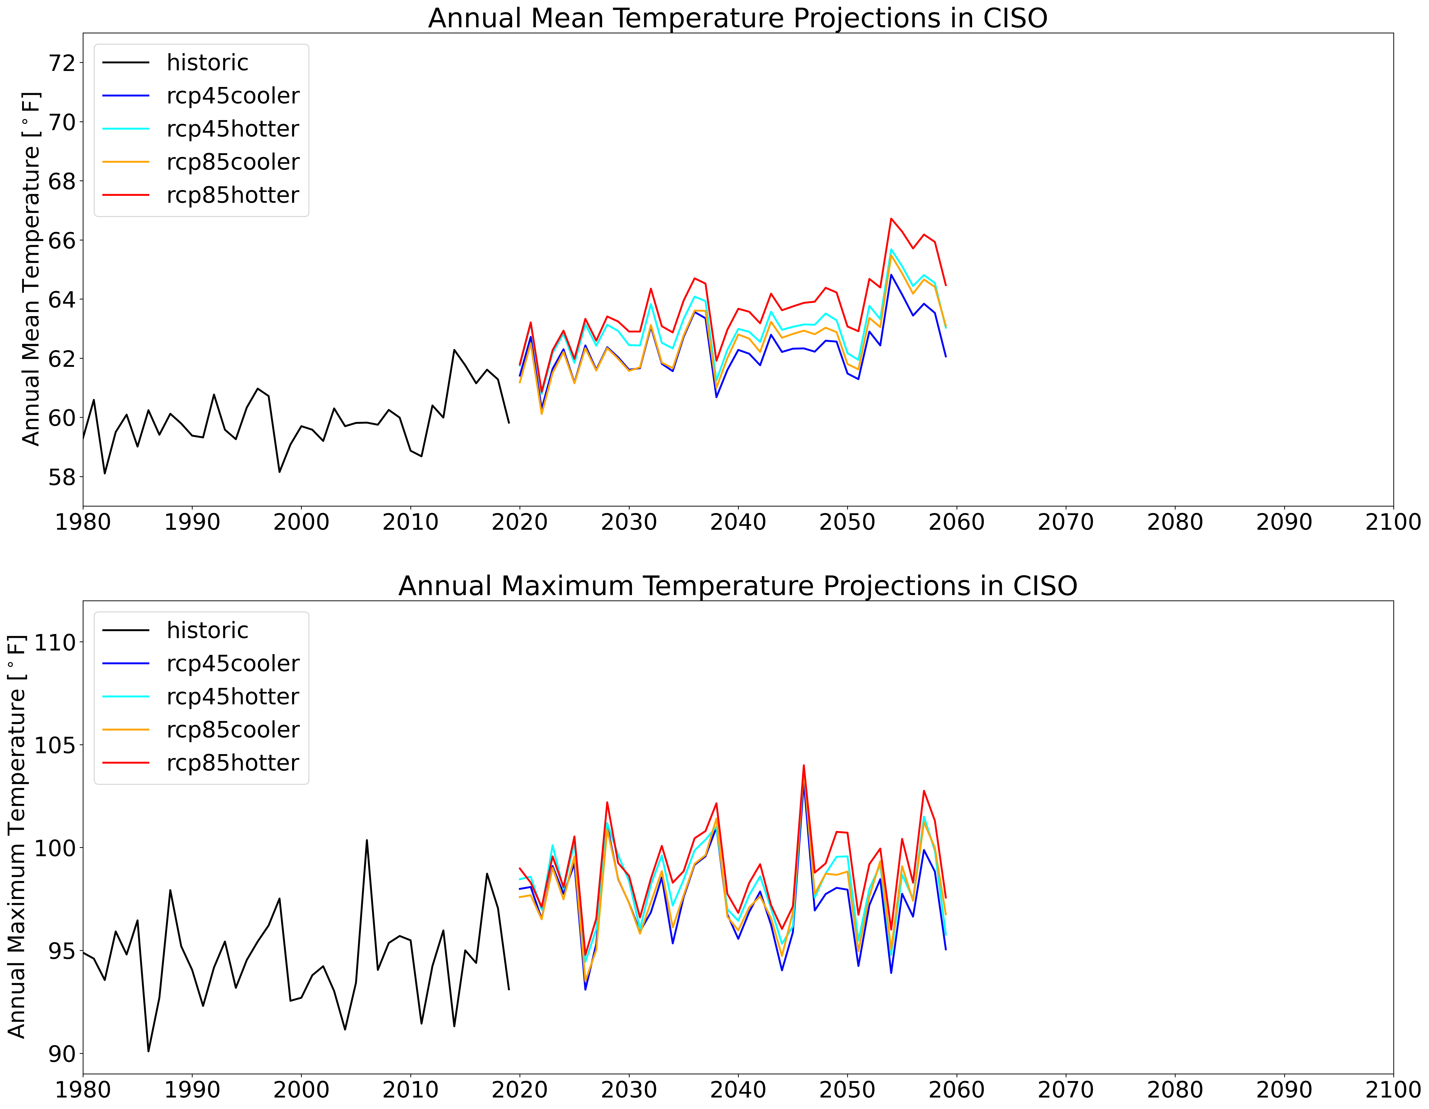
U.S. Climate Projection Dataset
Historic data reproduces observed sequence of past events (1980–2019)
Sequence is repeated twice in the future (2020–2059 and 2060–2099) with additional warming gradually applied
1/8 deg (~12 km) resolution, U.S., hourly
25 hourly and 250+ three-hourly variables
Output is first spatially-averaged by county then population-weighted to create annual 8,760-hr meteorology time series for 54 BAs across the U.S.
Hot Year
40 years
Climate data was developed with DOE Sc funding and is publicly available: https://data.msdlive.org/records/cnsy6-0y610

Slide 6
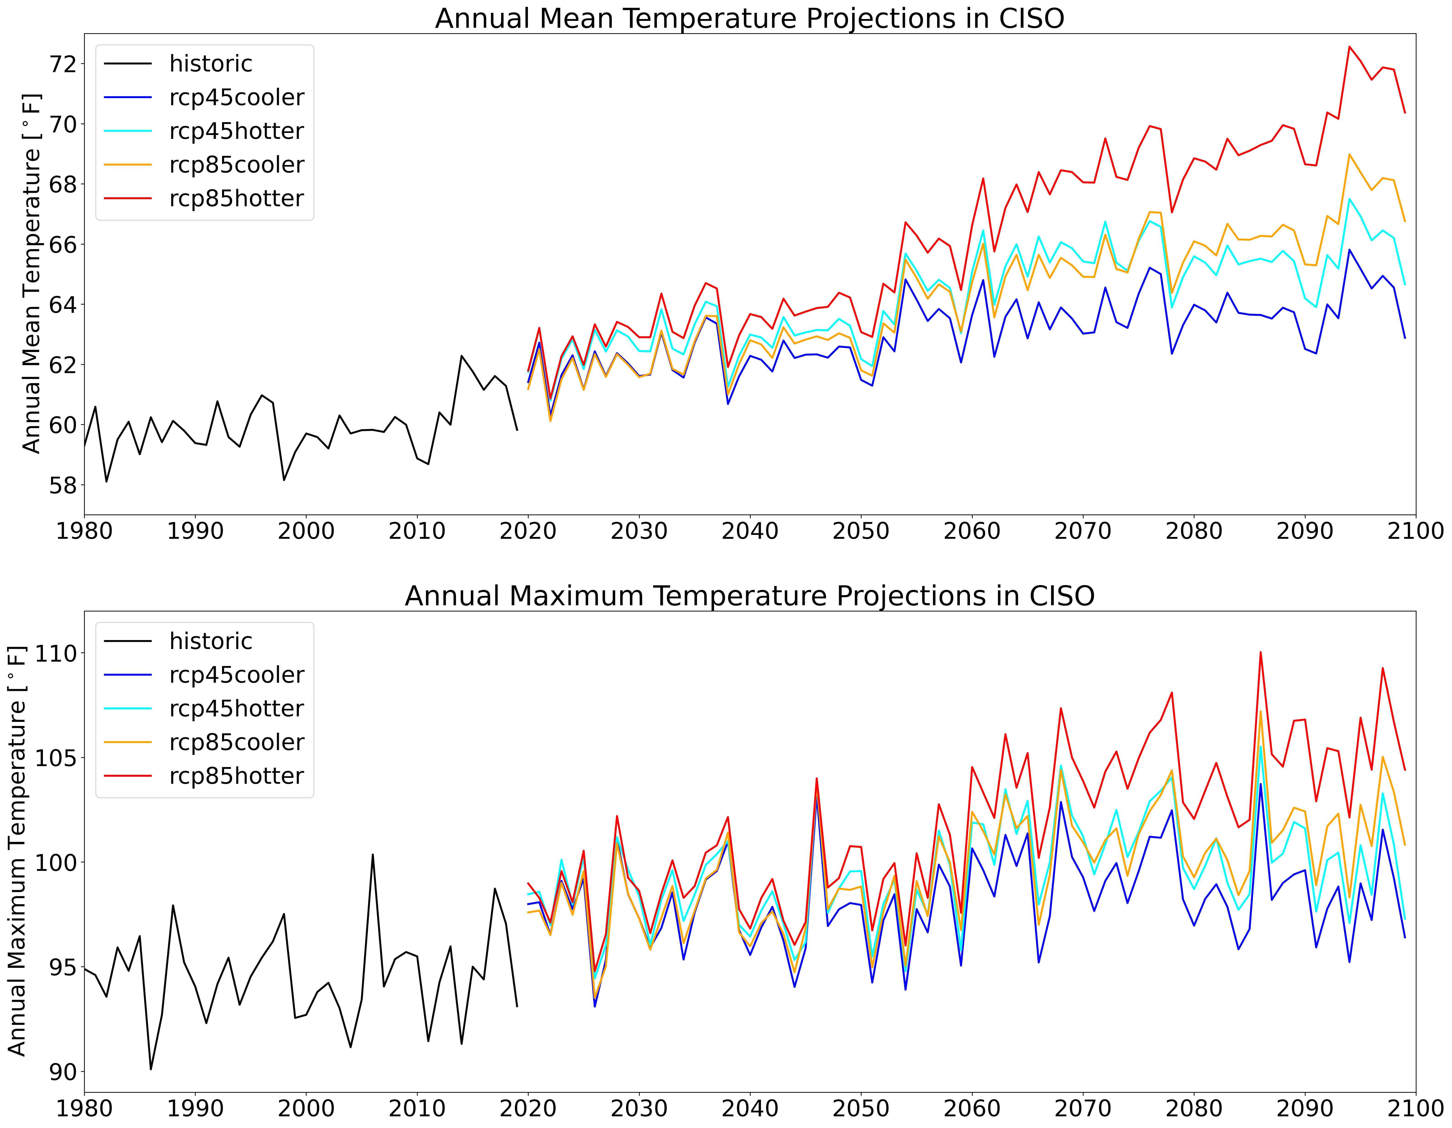
U.S. Climate Projection Dataset
Historic data reproduces observed sequence of past events (1980–2019)
Sequence is repeated twice in the future (2020–2059 and 2060–2099) with additional warming gradually applied
1/8 deg (~12 km) resolution, U.S., hourly
25 hourly and 250+ three-hourly variables
Output is first spatially-averaged by county then population-weighted to create annual 8,760-hr meteorology time series for 54 BAs across the U.S.
Hot Year
40 years
Climate data was developed with DOE Sc funding and is publicly available: https://data.msdlive.org/records/cnsy6-0y610

Slide 7
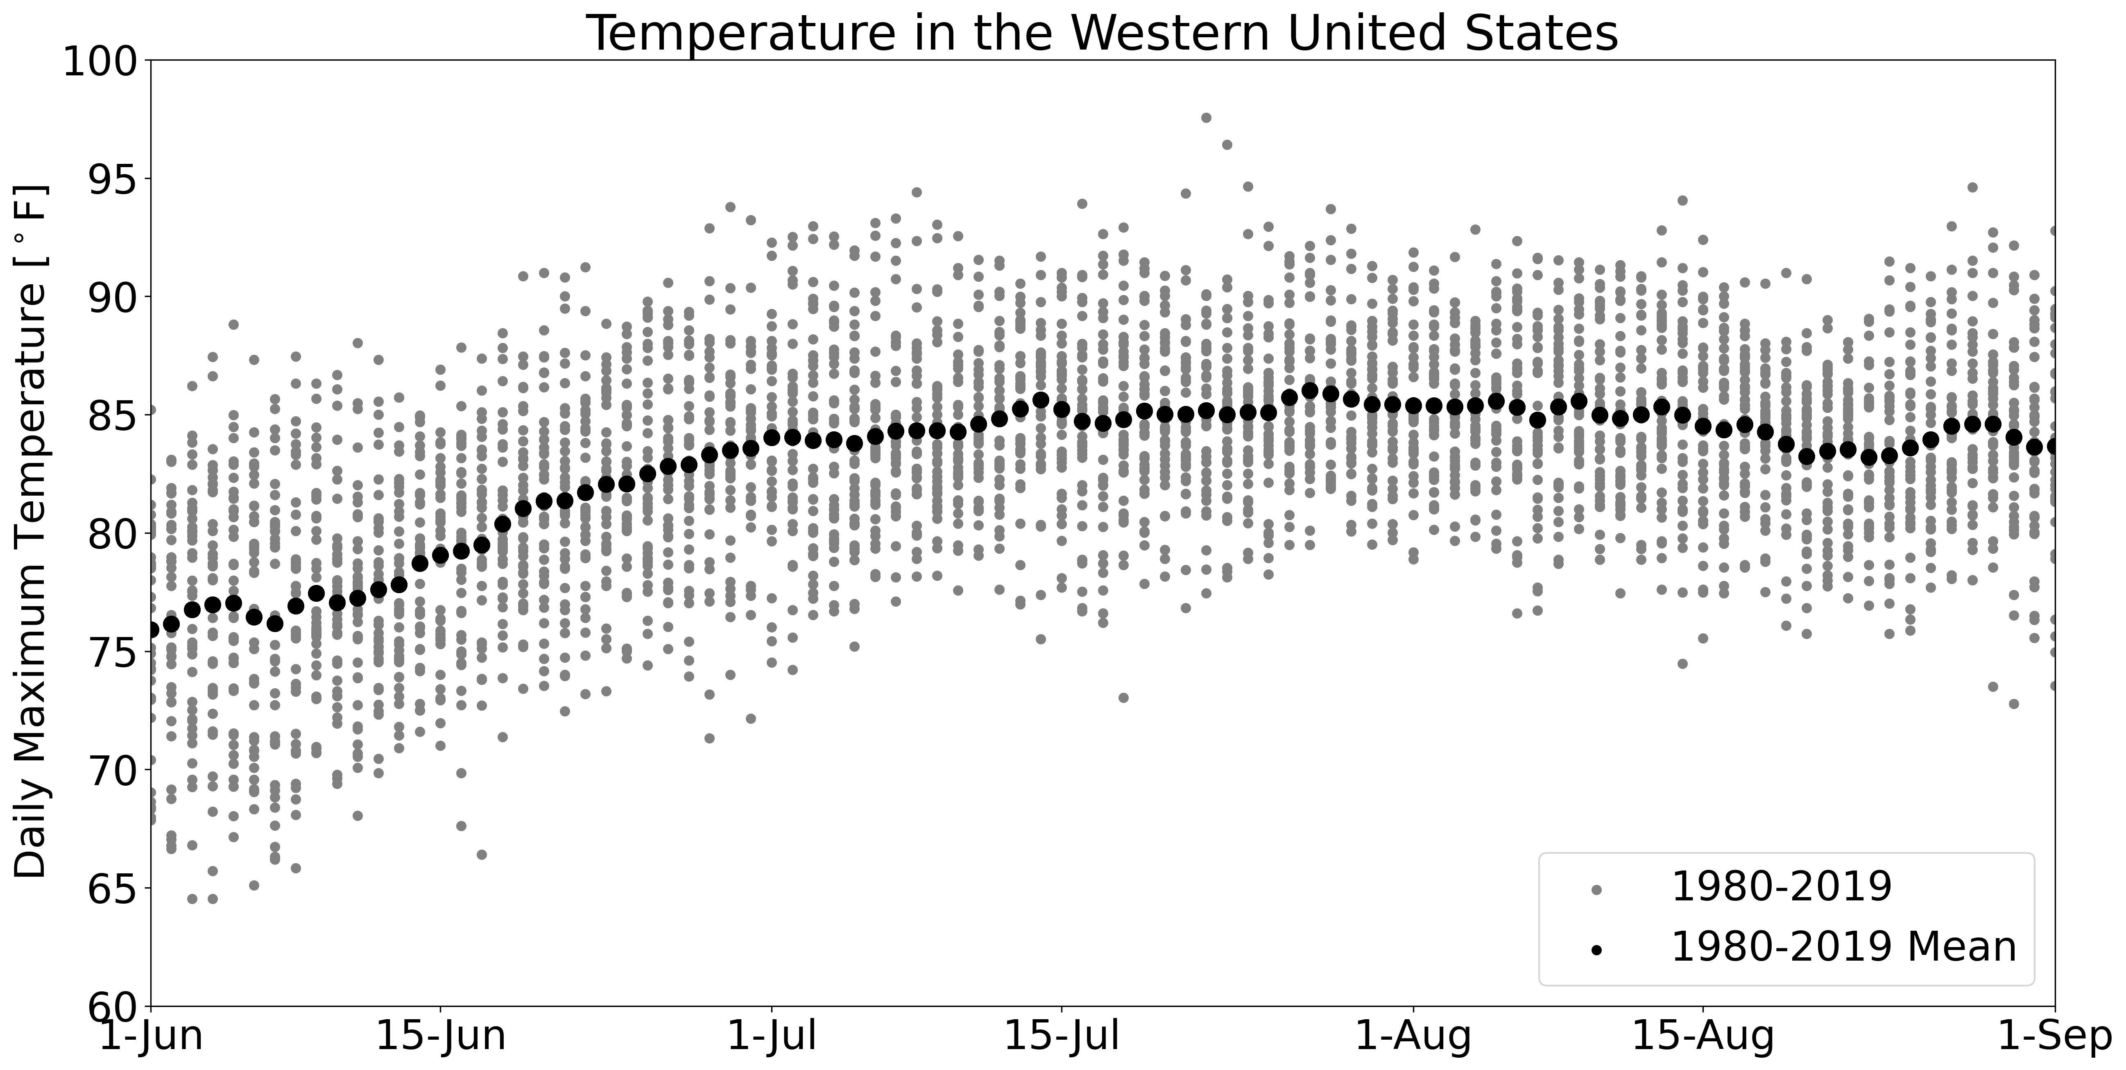
Finding Heat Wave Events

Slide 8
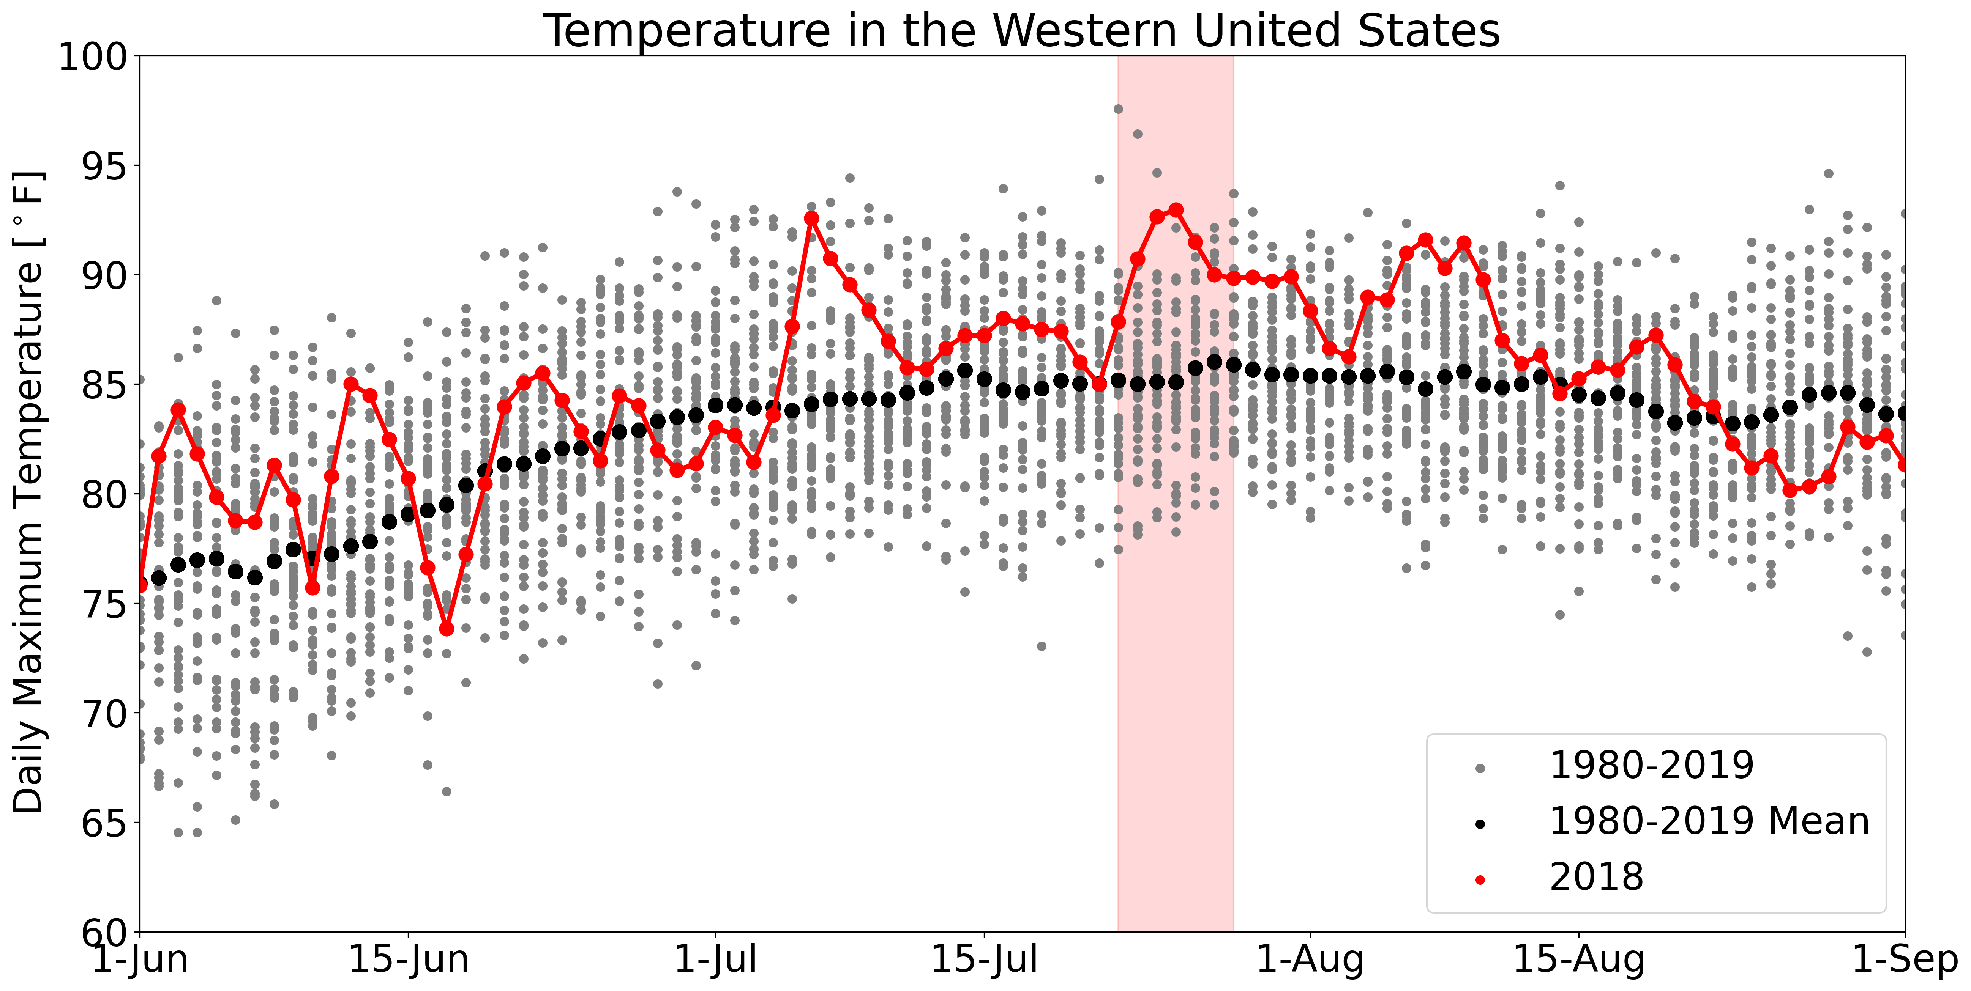
Finding Heat Wave Events

Slide 9
Finding Heat Wave Events
Notes:
- Wife was 41 weeks pregnant during this week and was about as miserably hot as you can possibly be.

Slide 10
Exploring Historical Heat Wave Grid Stress
https://doi.org/10.57931/2001010

Slide 11
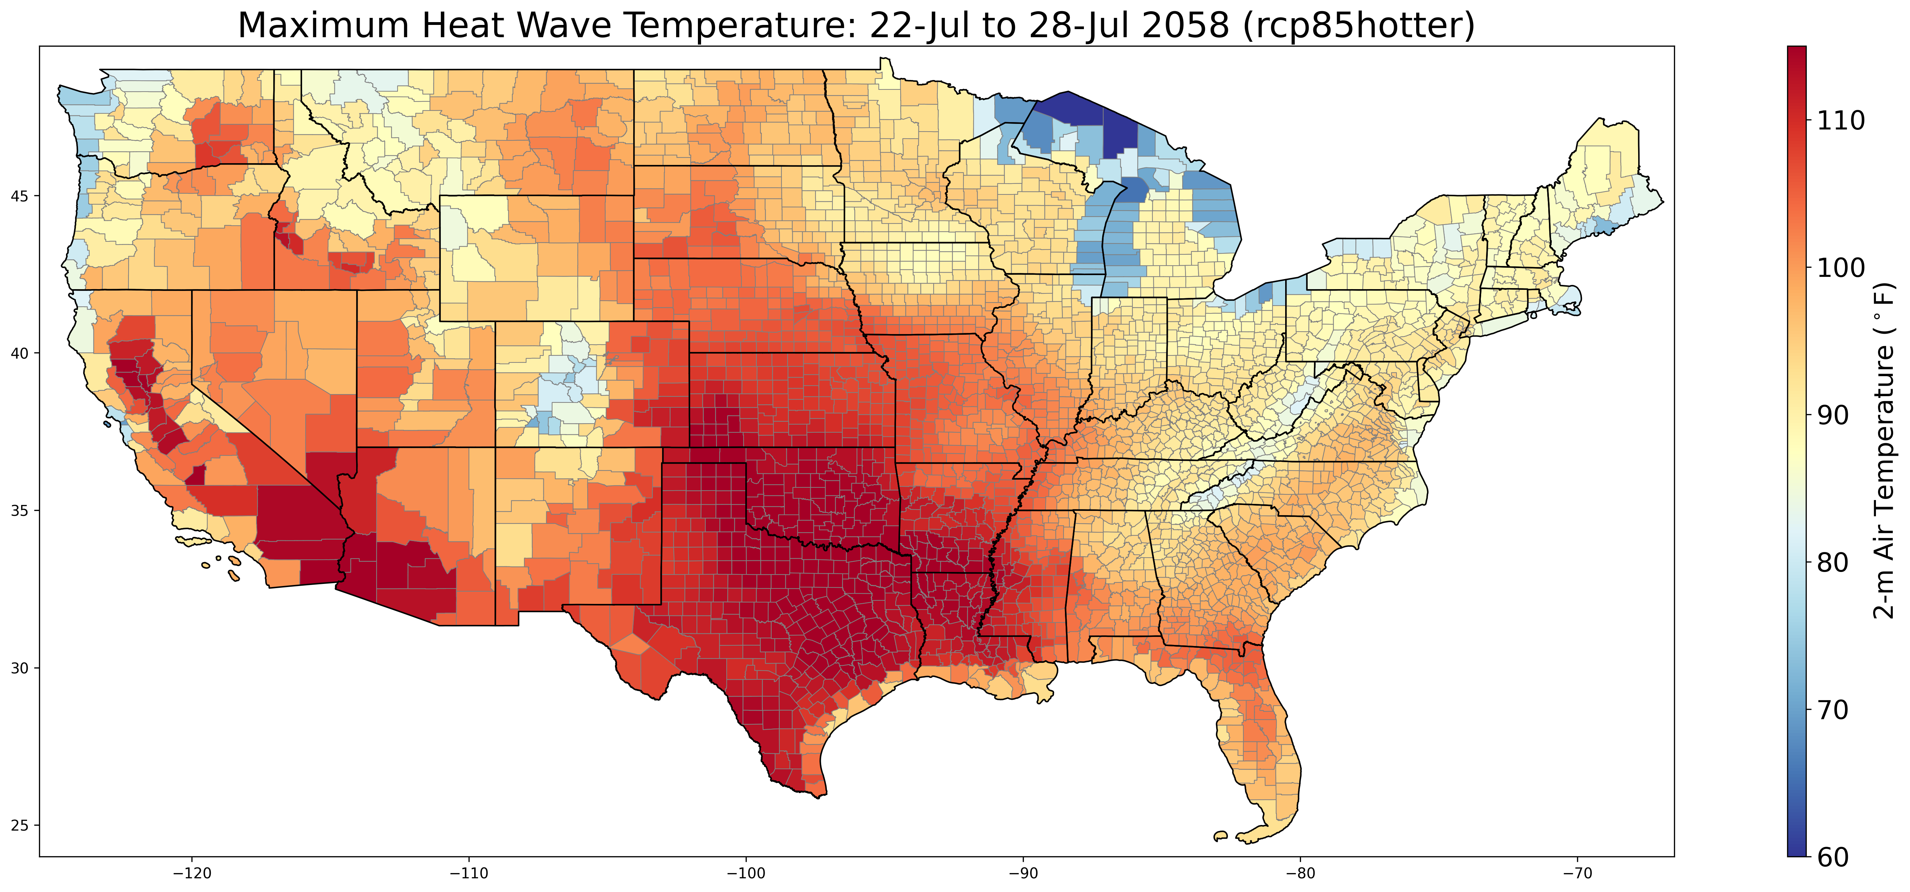
Exploring Future Heat Wave Grid Stress
Climate Change Impact on 2018 Heat Wave
Historical
Projected

Slide 12
Exploring Future Heat Wave Grid Stress
https://doi.org/10.57931/2001010

Slide 13
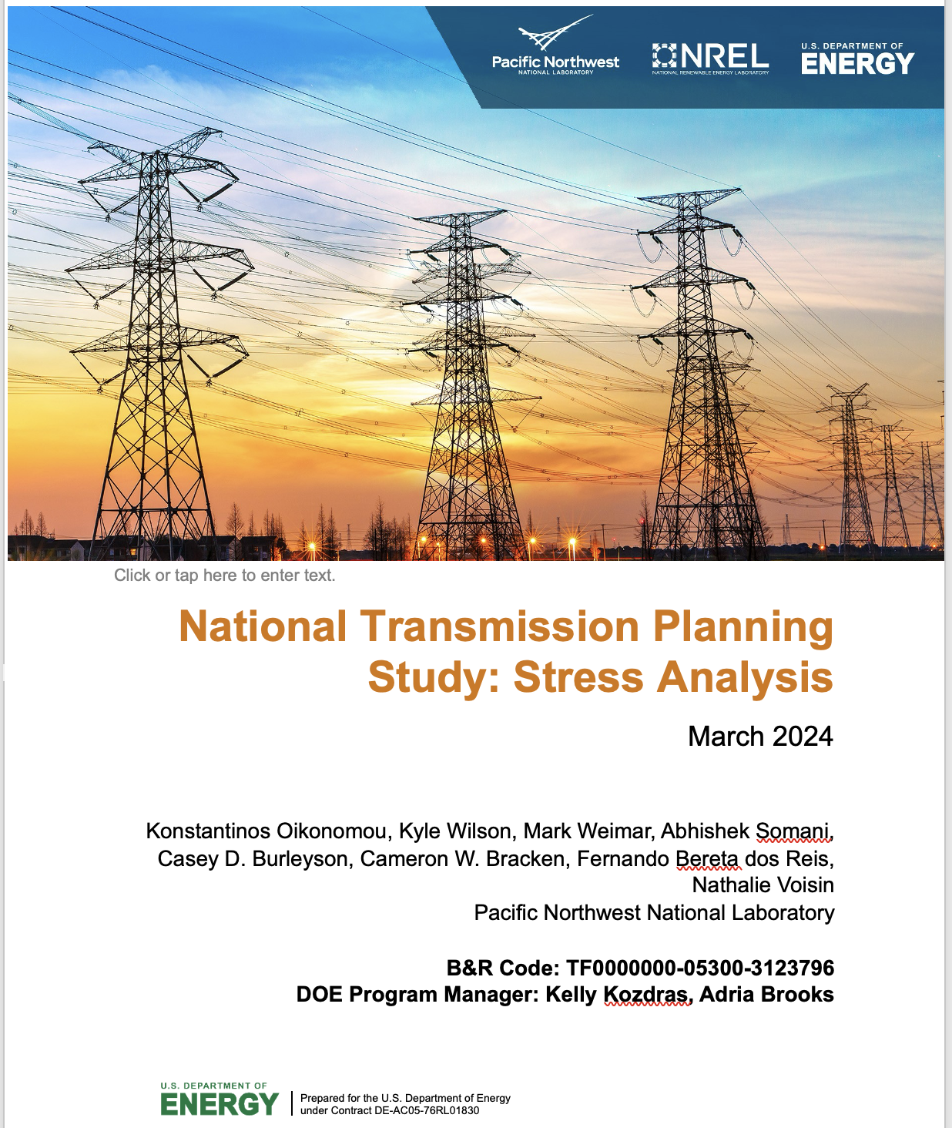
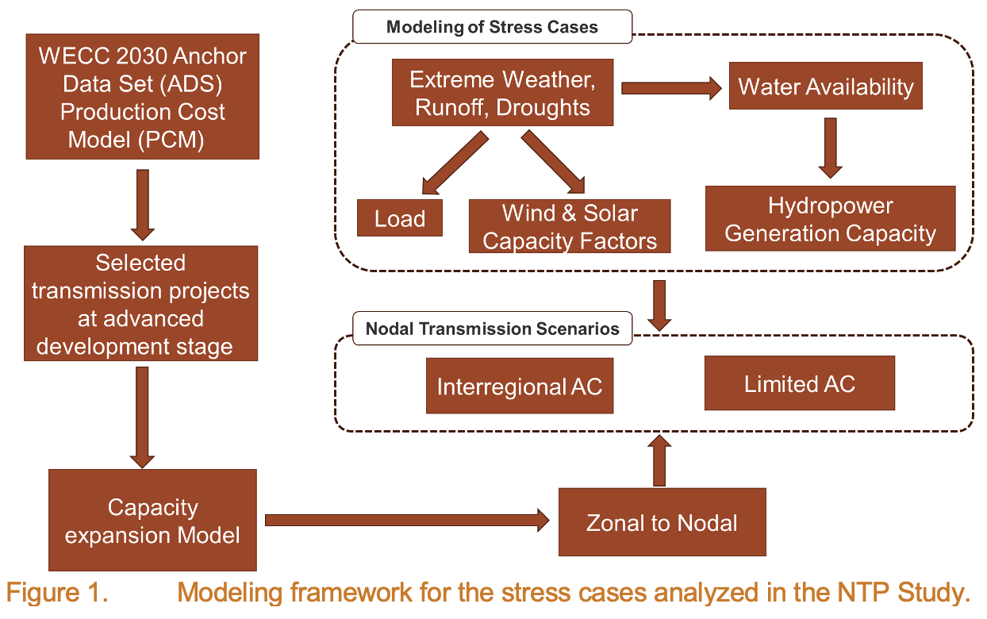
Stress Tests for Understanding Resilience of System Projections
Projects like the National Transmission Planning Study (NTPS) are using the historical and future meteorology to test the resilience of their projected system to extreme weather events.
COMING SOON

Slide 14
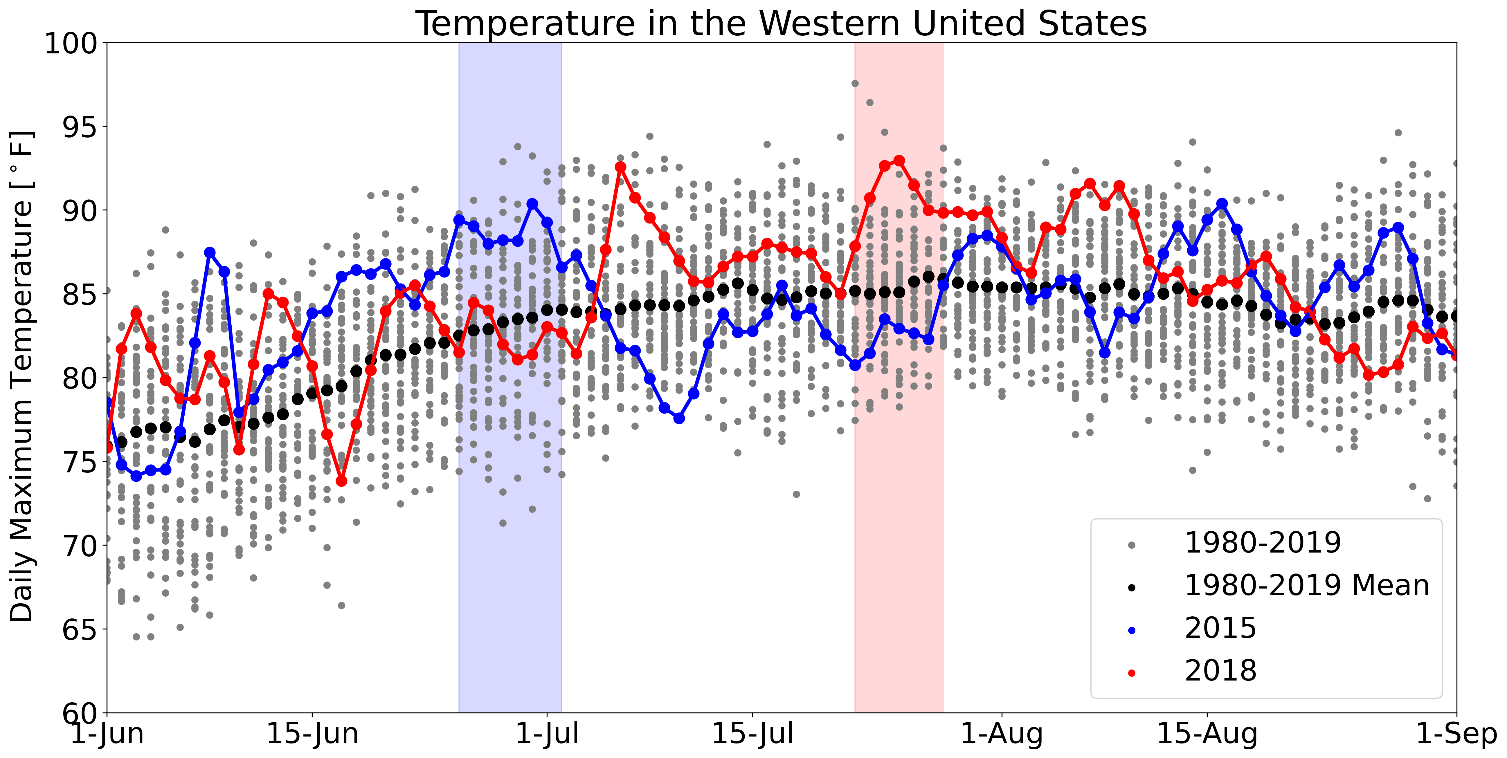
Exploring Resilience Across a Range of Contrasting Events

Slide 15
Exploring Resilience Across a Range of Contrasting Events
2015 heat wave event used in NTPS was WECC-wide
2018 event was more concentrated in California and the desert southwest

Slide 16
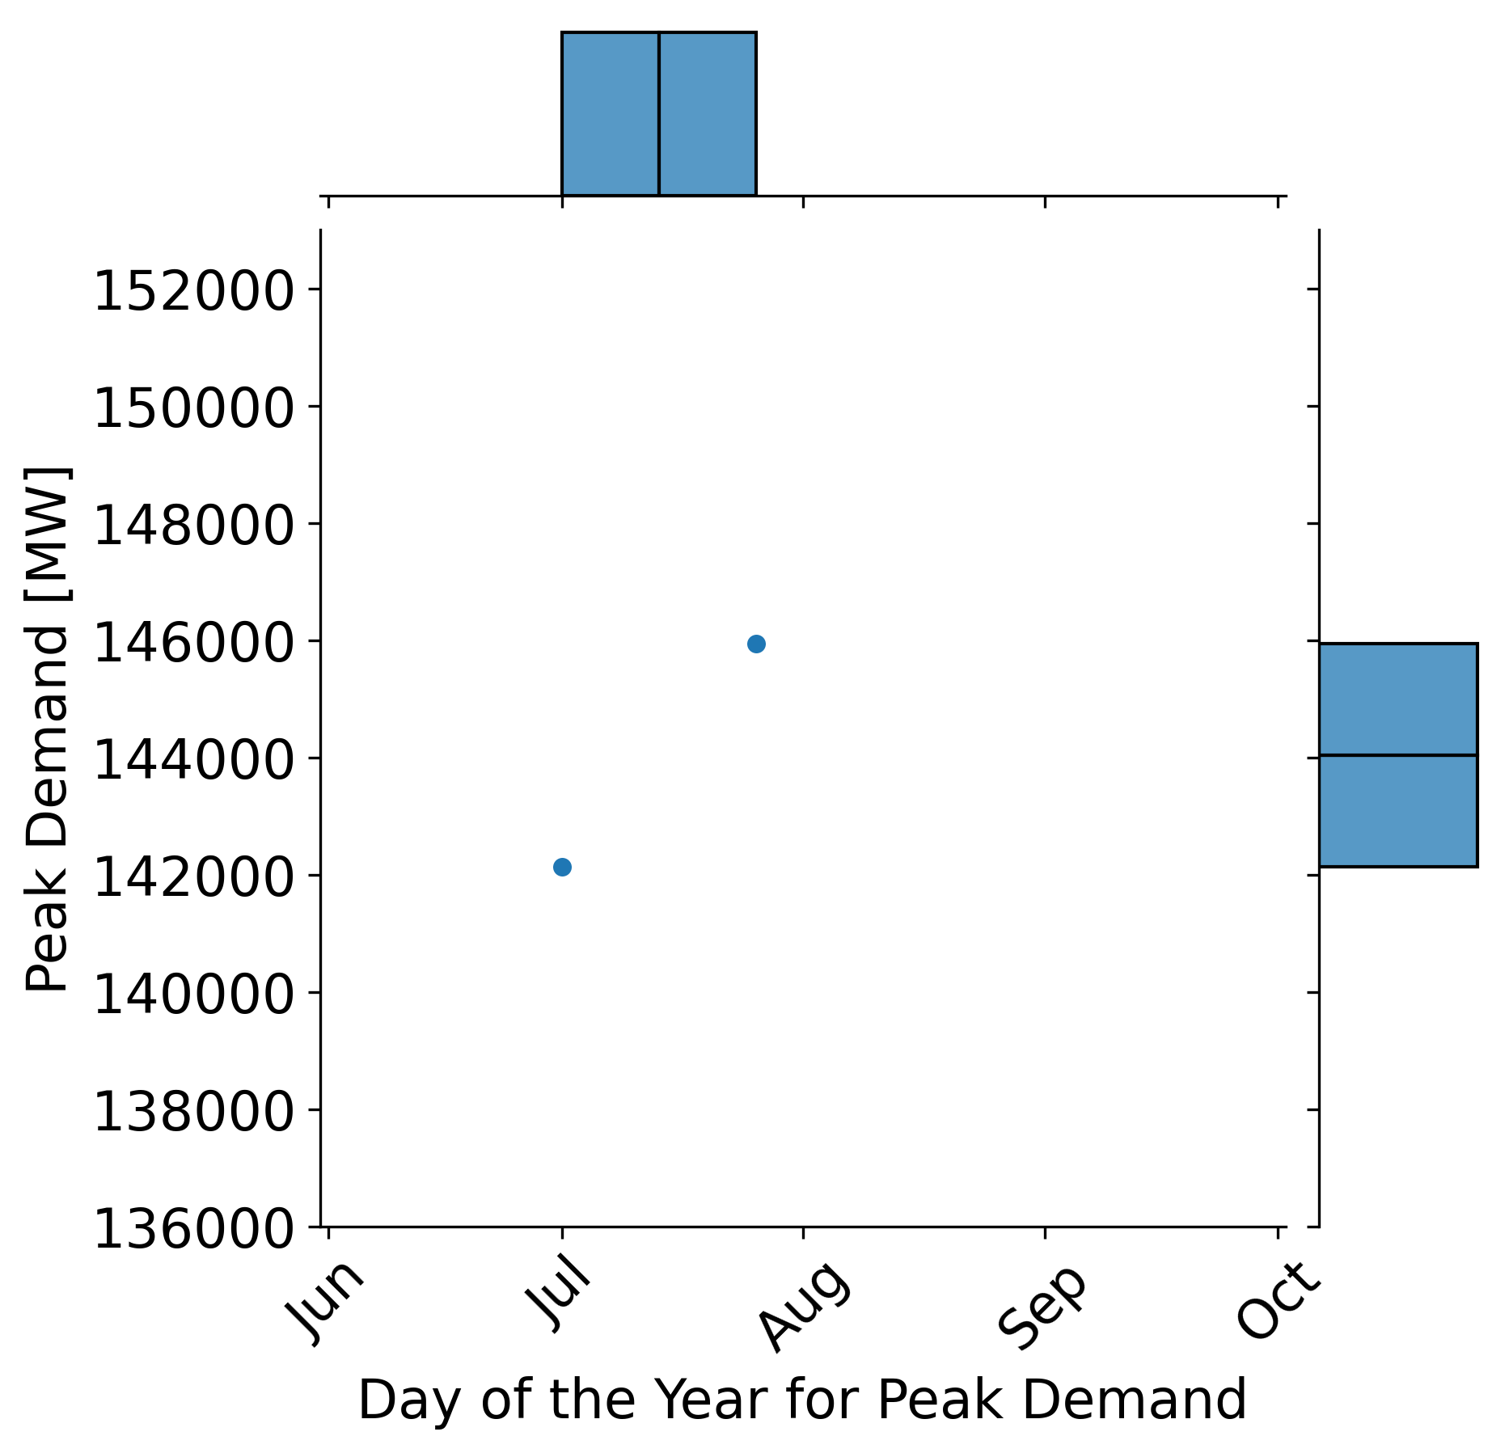
Simulating Multiple Weather Years to Explore Uncertainty
2018 weather year
We can run many unique weather years through PNNL’s wind, load, and solar models:
All years have the same total annual energy consumption by design
Absolute magnitude and timing of peak demand varies significantly depending on the weather each year
2015 weather year

Slide 17
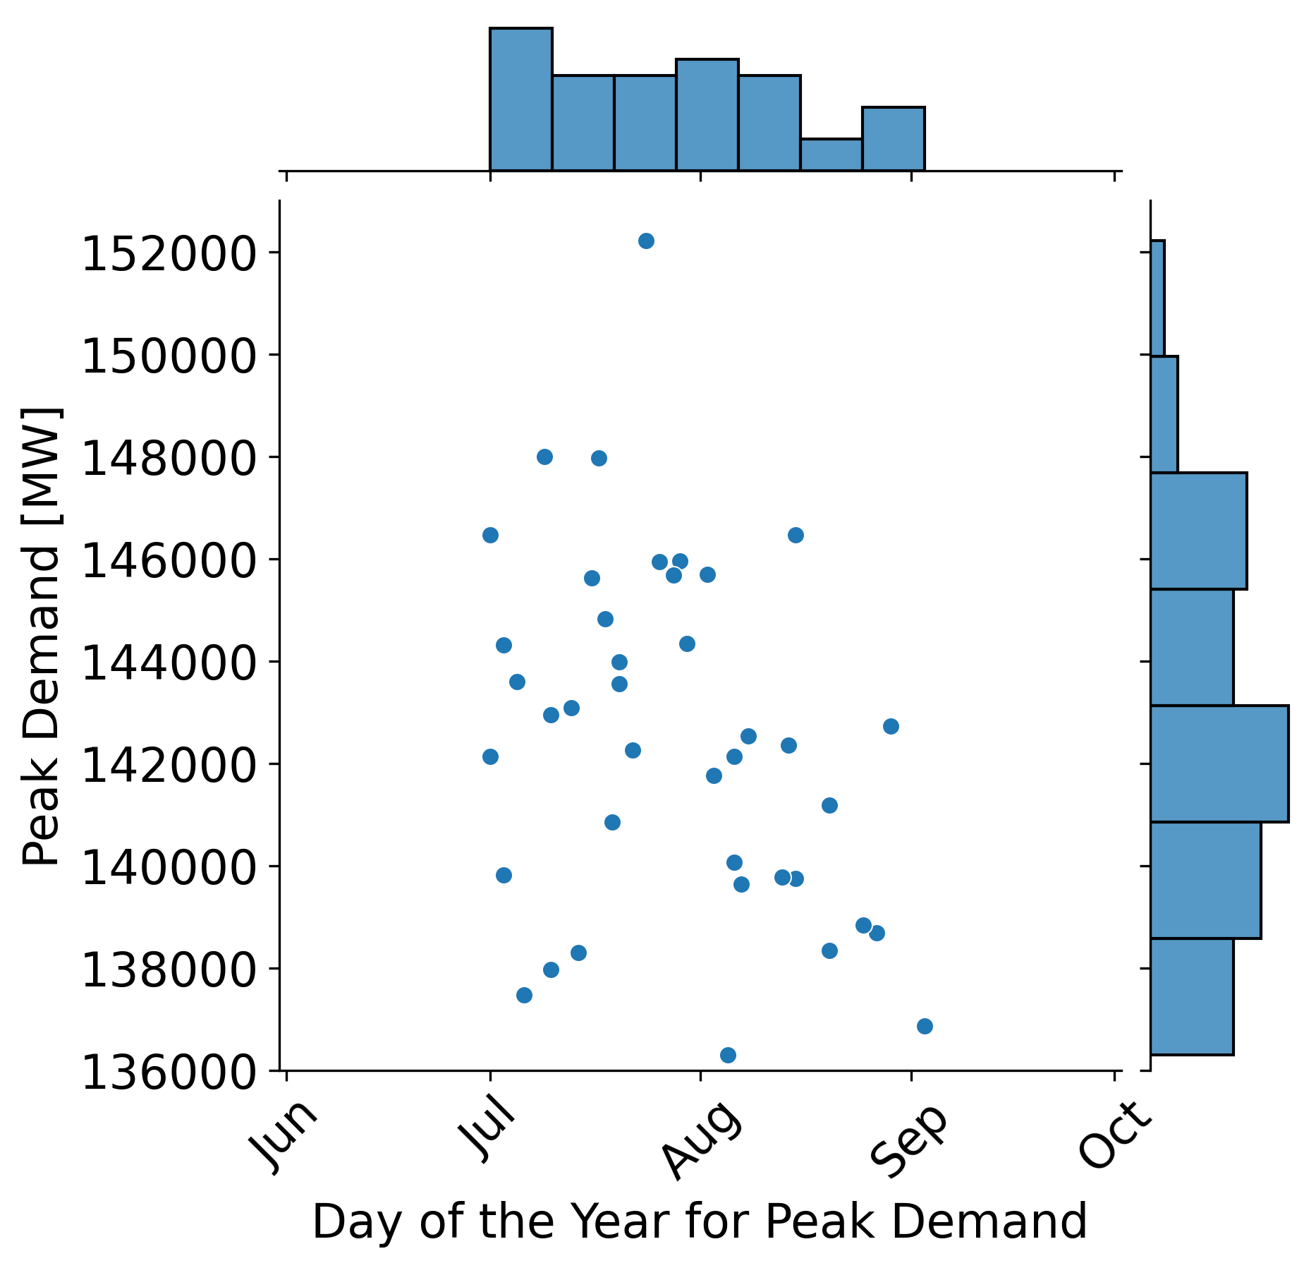
Simulating Multiple Weather Years to Explore Uncertainty
Select weather years with extreme peaks for testing resilience…
We can run many unique weather years through PNNL’s wind, load, and solar models:
All years have the same total annual energy consumption by design
Absolute magnitude and timing of peak demand varies significantly depending on the weather each year
Select weather years with late season peaks to assess reliability with low hydro…

Slide 18
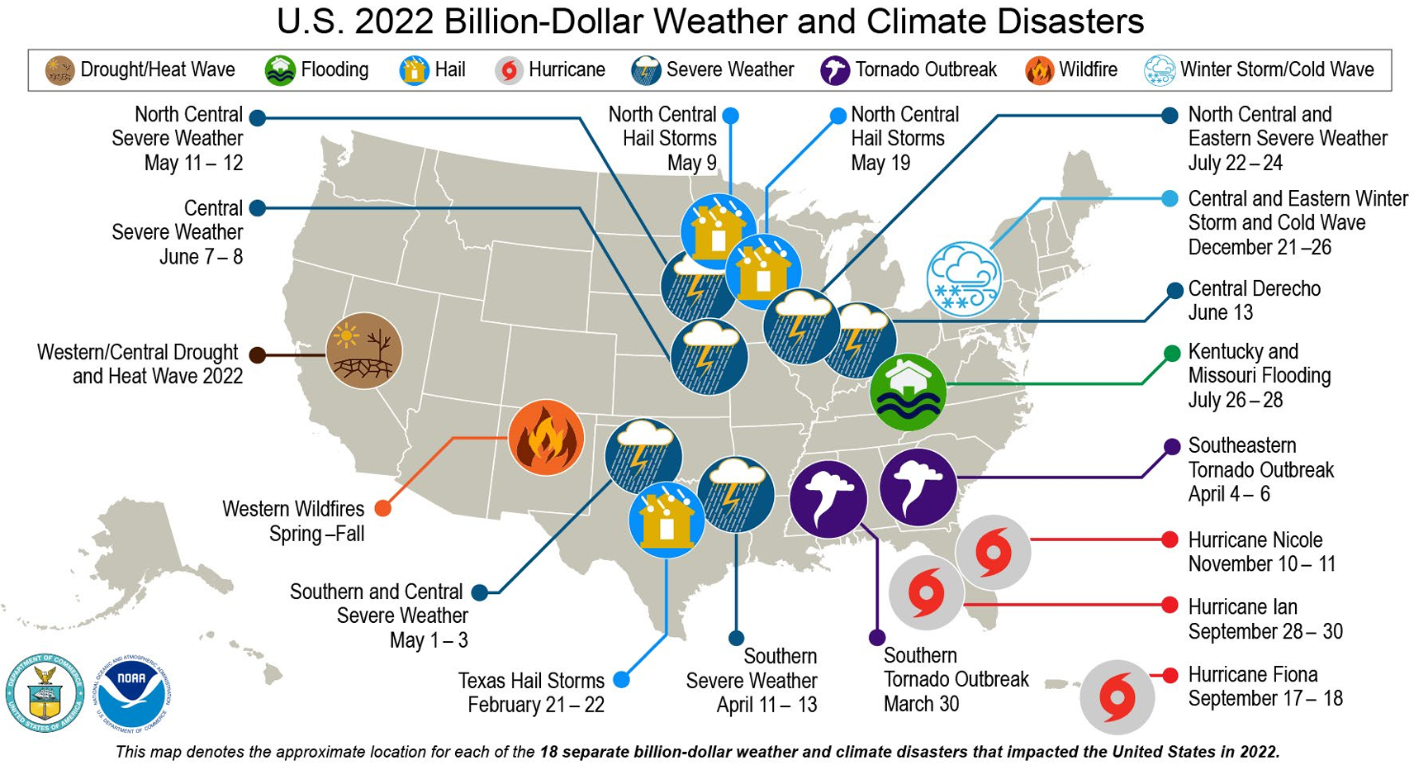
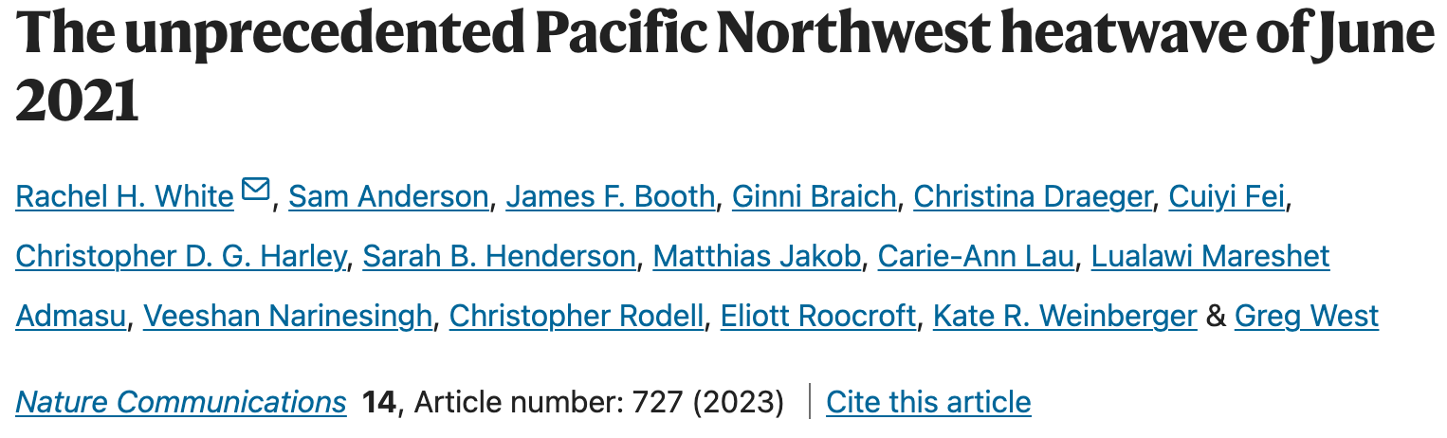
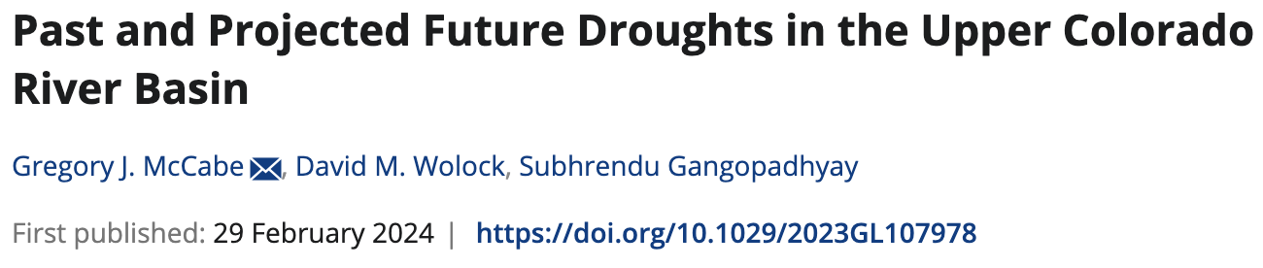
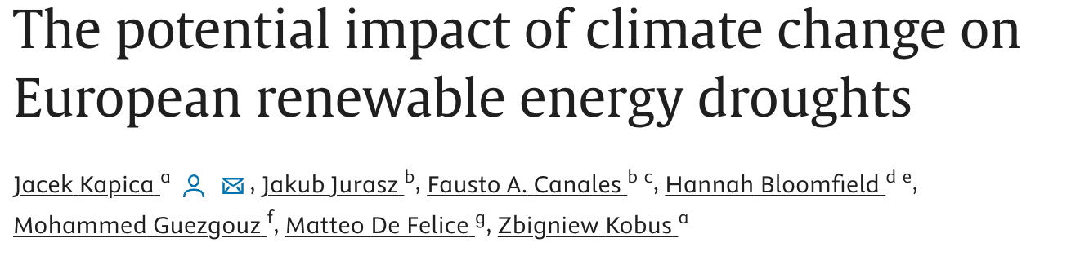
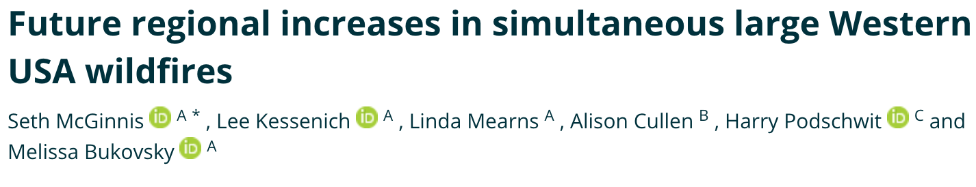
Isolated, Compounding, and Sequential Extreme Events
Bissolli, P., C. Ganter, A. Mekonnen, A. Sánchez-Lugo, and Z. Zhu, Eds., 2023: Regional Climates [in “State of the Climate in 2022“]. Bull. Amer. Meteor. Soc., 104 (9), S366–S473, https://doi.org/10.1175/2023BAMSStateoftheClimate_Chapter7.1.

Slide 19
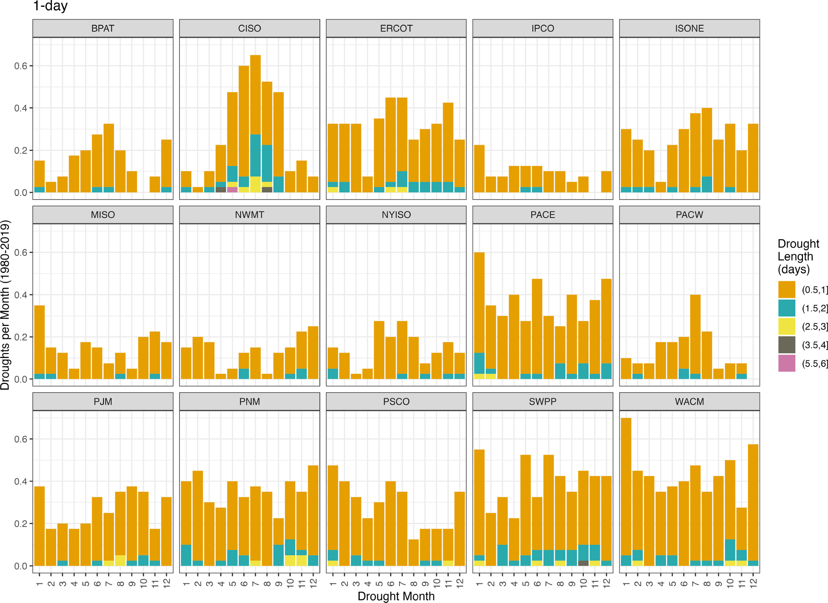
Coincident Datasets Help Identify Periods of Potential Stress
Energy droughts are periods of simultaneously suppressed wind and solar potential.
Characterizing energy droughts helps to understand storage and regional transmission needs.
Bracken, C. W., et al., 2023: Standardized benchmark of historical compound wind and solar energy droughts across the continental United States. Renewable Energy, 220, doi:10.1016/j.renene.2023.119550.

Slide 20
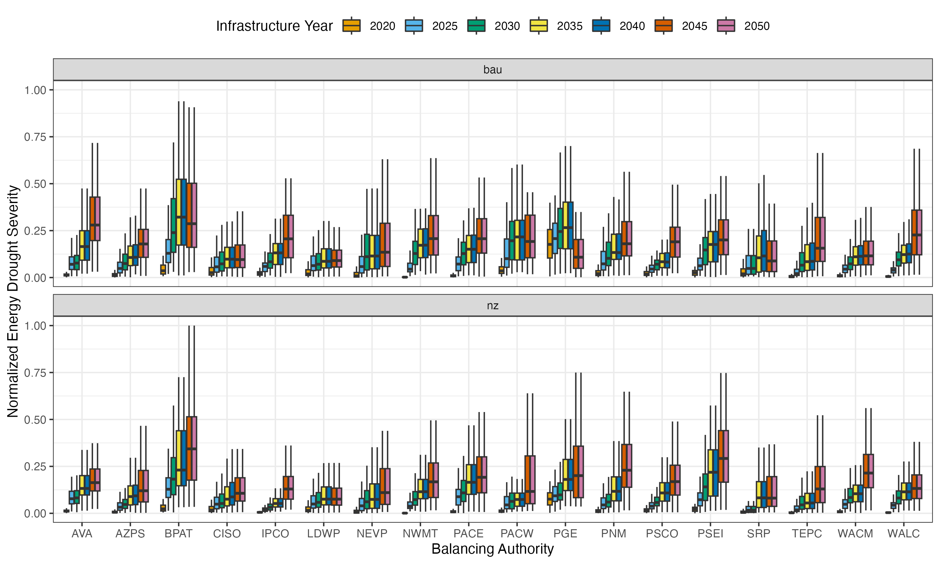
Energy Droughts Matter More in a Decarbonized System
The relative severity of energy droughts is expected to increase due to increased capacity of renewables.
The amount of increase depends on the potential for buildout within a particular BA.
Bracken, C. W., et al., 2024: Future energy droughts. In preparation for Renewable Energy.

Slide 21
Continuum of Stress Testing Approaches
Good
Testing using historical load-wind-solar-hydro data for a limited number of specific historical events
Testing using data for a wide range of historical events
Better
Testing using data based on forcing from a single climate dataset
Testing using data based on forcing from multiple climate datasets
Best

Slide 22
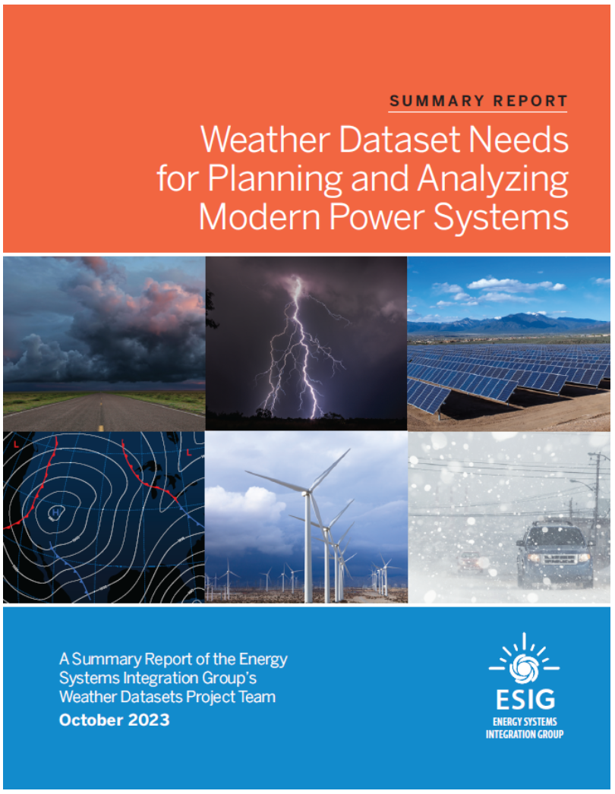
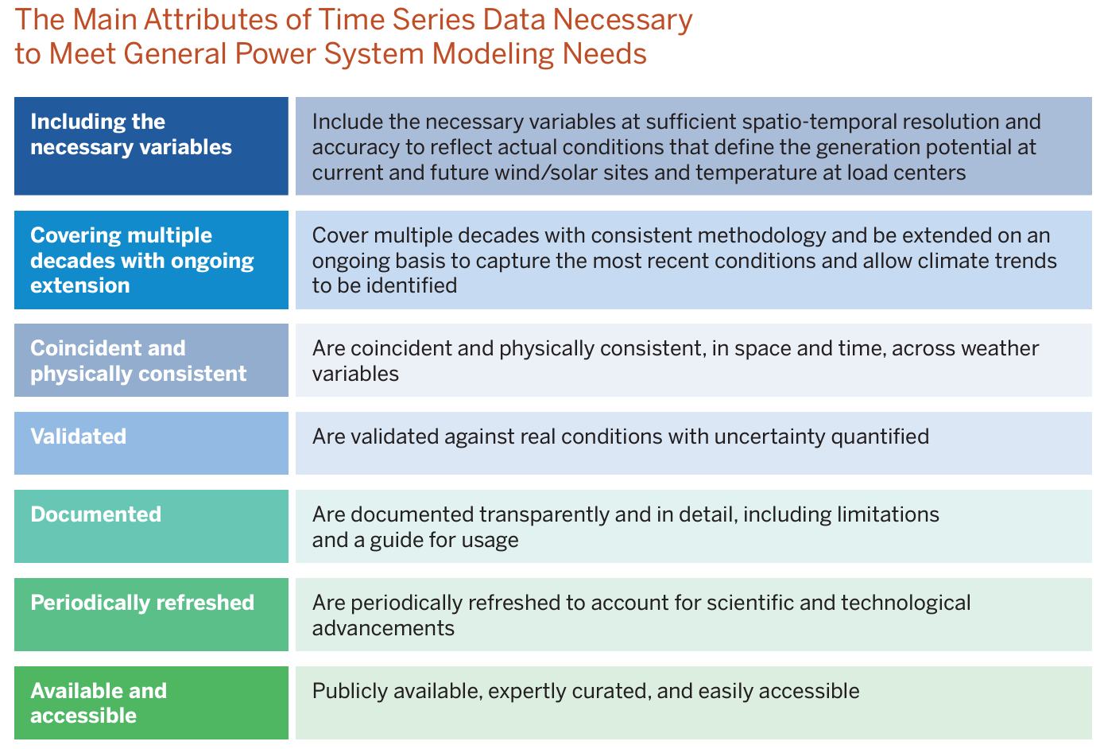
Continuum of Stress Testing Approaches
Good
Testing using historical load-wind-solar for a limited number of specific historical events
Testing using historical load-wind-solar for a wide range of historical events
Better
Testing using projected load-wind-solar based on forcing from a single climate dataset
Testing using data based on forcing from multiple climate datasets
Best

Slide 23
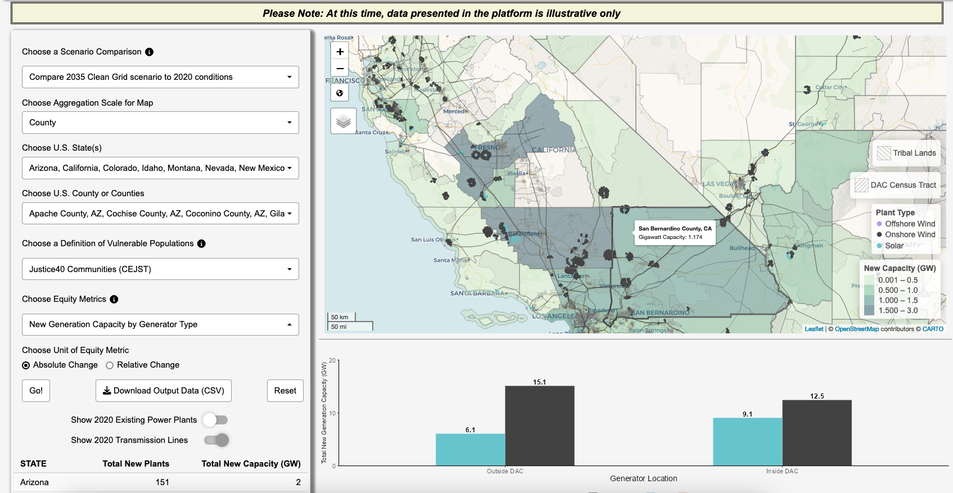
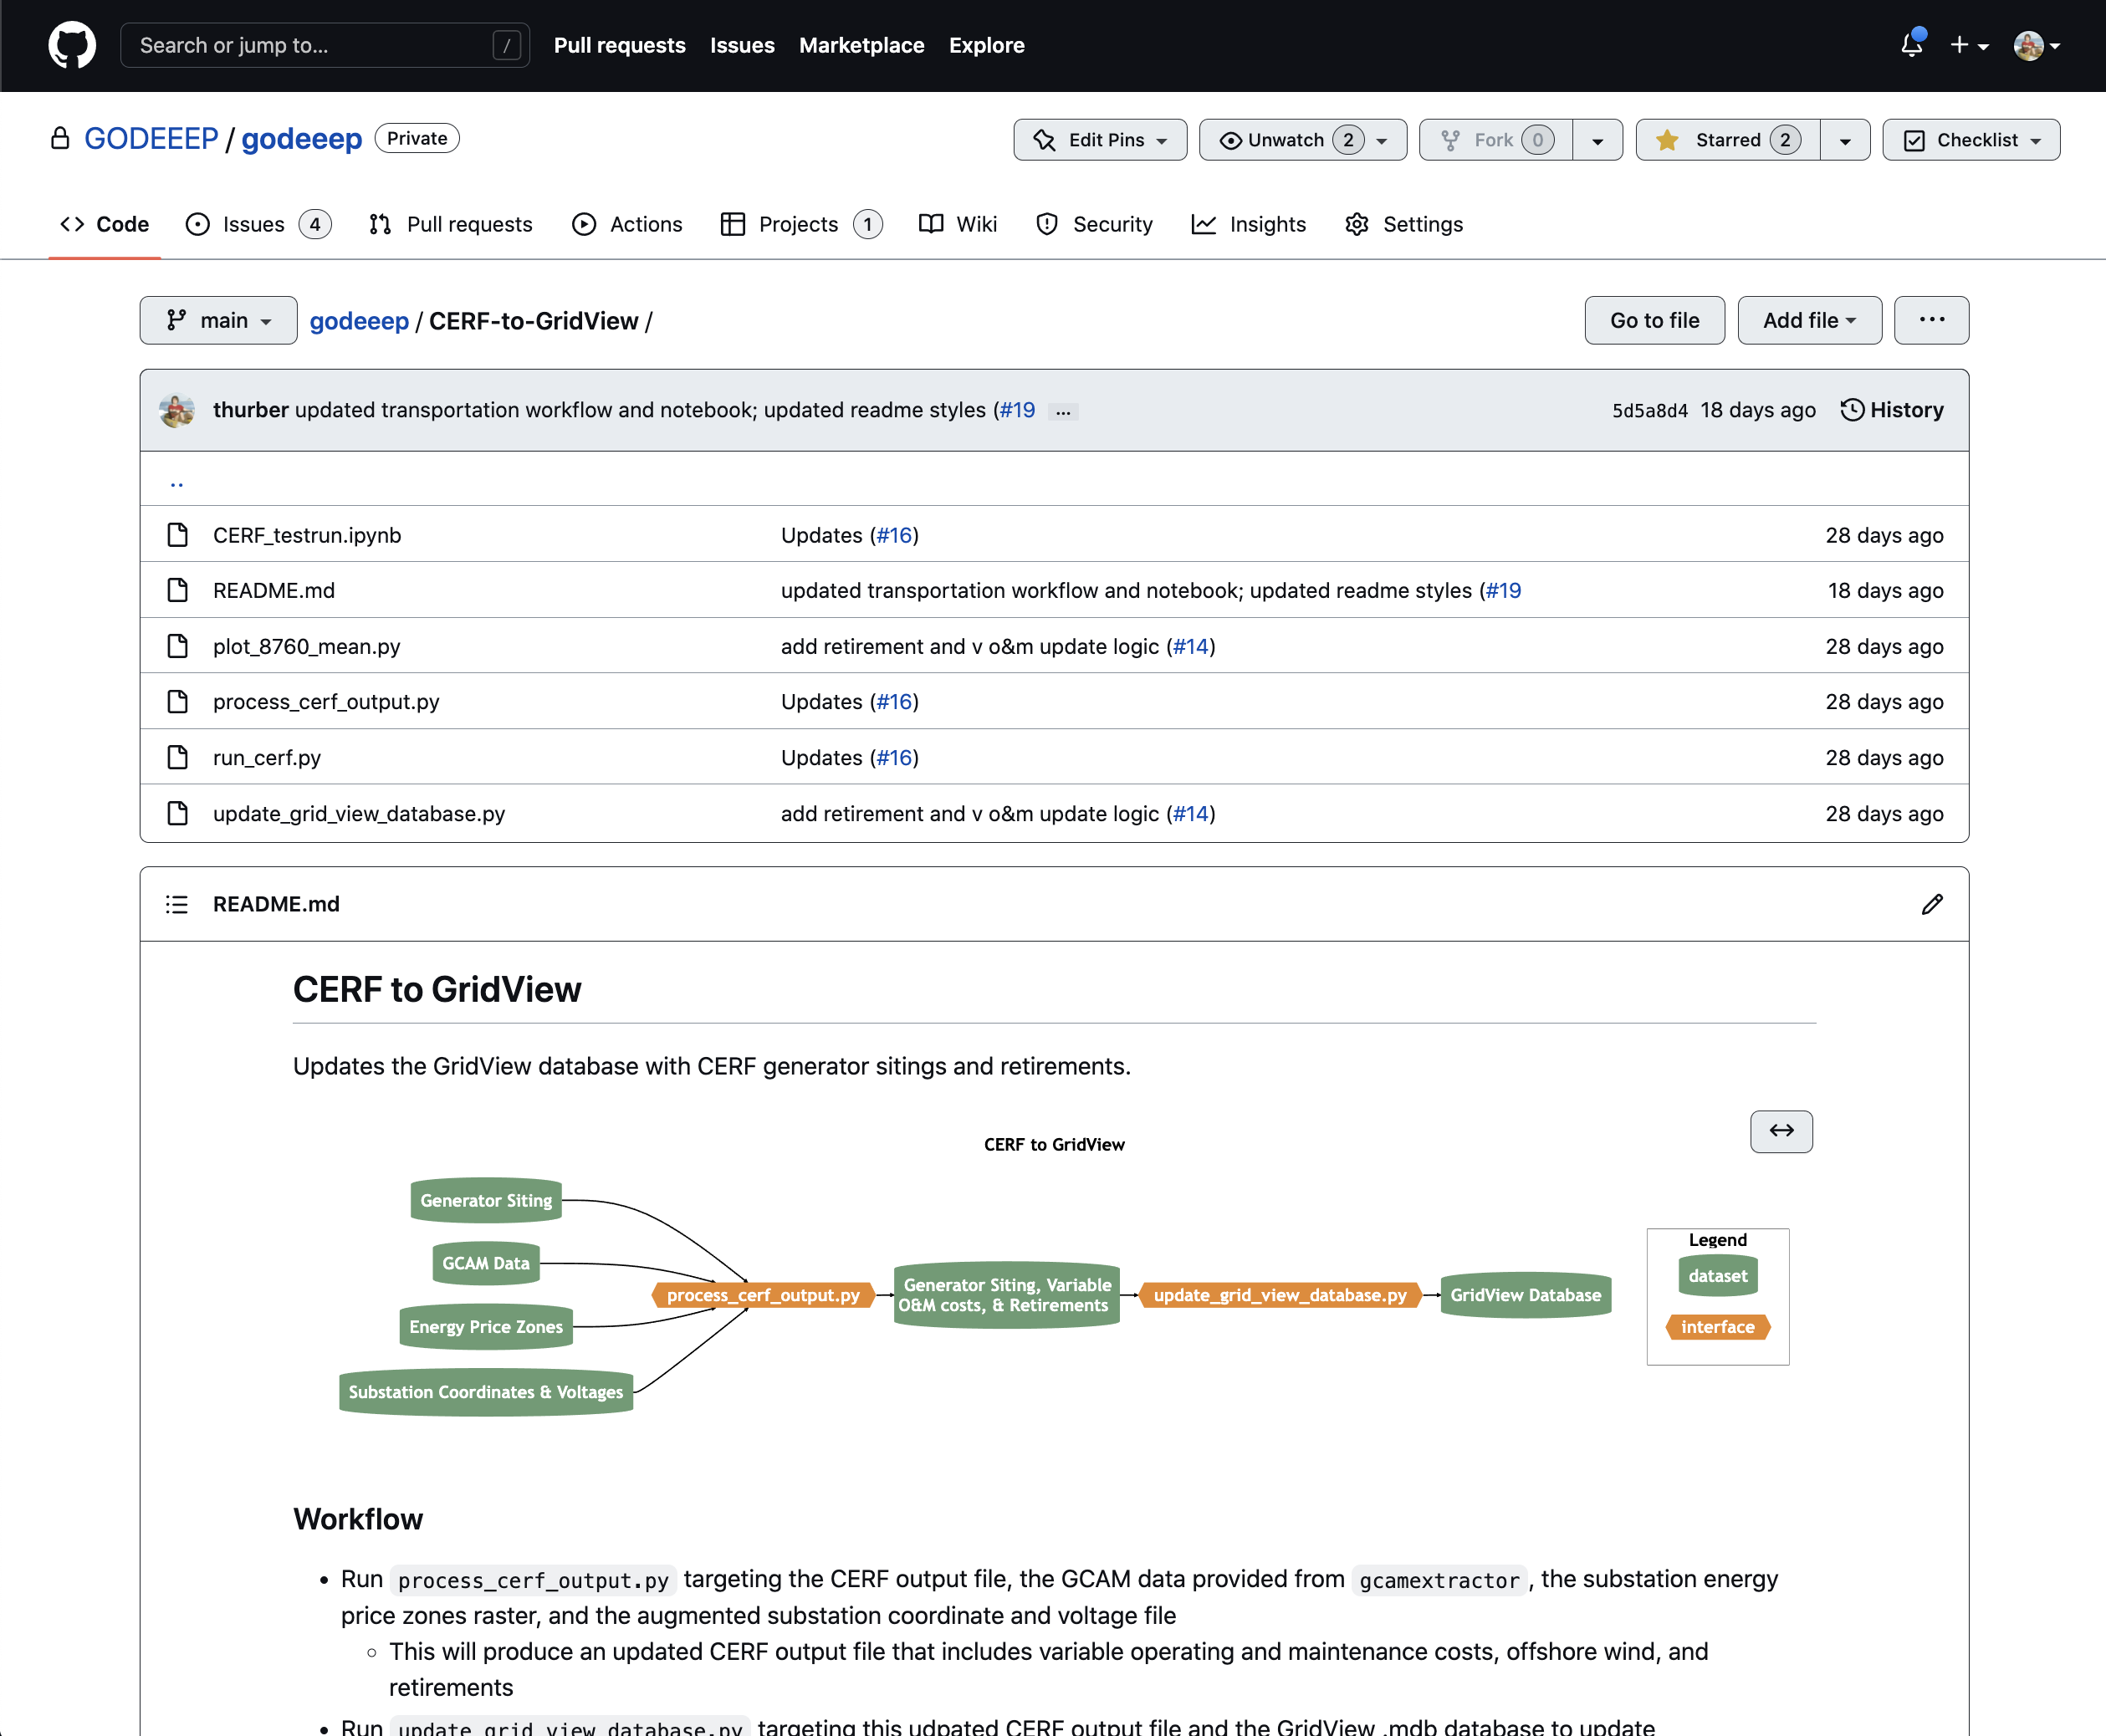
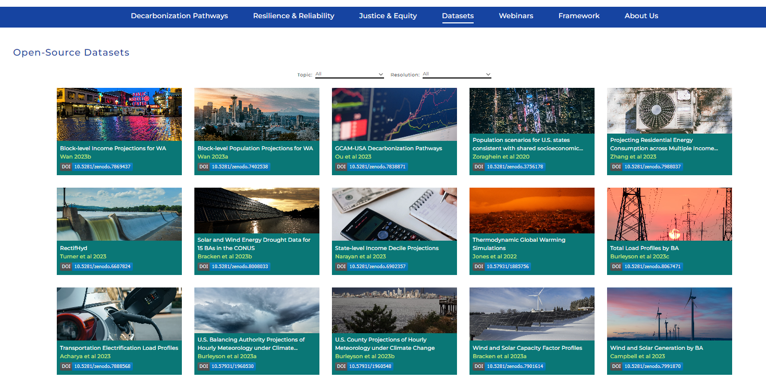
Sharing Data and Models
Open-source, vetted datasets are available in multiple formats in support of targeted questions by industry.
godeeep.pnnl.gov

Slide 24
Key Messages and Results
To assess the resilience and reliability of the bulk power system, it is critical to evaluate system performance with coincident load-wind-solar-hydro conditions and across a wide range of historical and projected weather conditions.
The conditions that stressed your system in the past may not be the ones that stress your system in the future. It is important to consider isolated, compounding, and sequential extreme events.
PNNL Innovations:
Open source spatially- and temporally-coincident load, wind, and solar data
Capture consistent and realistic impacts on electricity supply and demand for use in stress testing projected infrastructure
Quantitative characterization of wind and solar droughts
Contact: https://godeeep.pnnl.gov and casey.burleyson@pnnl.gov

Slide 25
Datasets, Models, and Funding
Key Datasets
Climate Forcing
Jones, A. D., Rastogi, D., Vahmani, P., Stansfield, A., Reed, K., Thurber, T., Ullrich, P., & Rice, J. S. (2022). IM3/HyperFACETS Thermodynamic Global Warming (TGW) Simulation Datasets (v1.0.0) [Data set]. MSD-LIVE Data Repository. https://doi.org/10.57931/1885756
Wind and Solar Generation
Bracken, C., Thurber, T., & Voisin, N. (2023). Hourly Wind and Solar Generation Profiles at 1/8th Degree Resolution (v1.0.0) [Data set]. Zenodo. https://doi.org/10.5281/zenodo.10214348
Key Models
Capacity Expansion Regional Feasibility (CERF): https://immm-sfa.github.io/cerf/
Grid Operations (GO): https://immm-sfa.github.io/go/
Renewable Energy Potential (reV): https://nrel.github.io/reV/
Total ELectricity Loads (TELL): https://immm-sfa.github.io/tell/
Funding
Various elements of this research were independently funded by DOE BER, DOE WPTO, and internal funding from PNNL

