Slide 1
Integration of Climate Forecasts in Bulk Power System Studies 26-October 2023
Casey Burleyson, Cameron Bracken, and Nathalie Voisin
PNNL-SA-191582
https://godeeep.pnnl.gov/

Slide 2
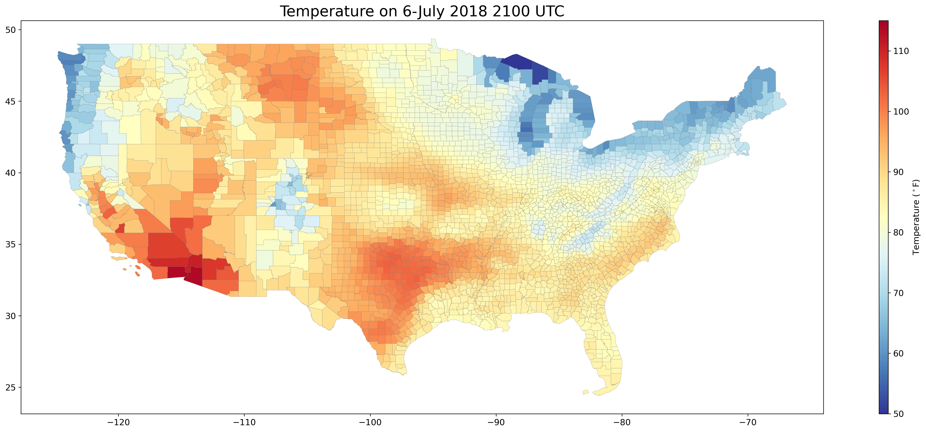
Assertions
The existing grid is weather sensitive.
Weather characteristics (e.g., extremes) are changing rapidly.
The grid is also changing rapidly.
A high renewables grid will be even more weather sensitive.

Slide 3
Key Messages
To assess the resilience and reliability of the bulk power system, it is critical to evaluate system performance:
With coincident load-wind-solar-hydro conditions;
Across a wide range of historical and projected weather conditions.

Slide 4
Consistent Integration of Climate Information Throughout the Long-Term Planning Process
Climate &
Social Sciences
Preferred Portfolio
Infrastructure Planning & Siting
Operations Planning & Investment
Define the portfolio of scenarios that will guide long-term planning
Analyze resource adequacy under seasonal representative stress events
Evaluate reliability, economic feasibility, and market incentives for least-cost, resilient operations
Datasets
Climate scenarios, taxes and incentives, market structures, net-zero, technology innovation
10, 20, and 30 year buildouts; wind, solar, load, and hydropower datasets; fuel prices
Electricity prices, technology-specific operations, transmission, storage, key performance

Slide 5
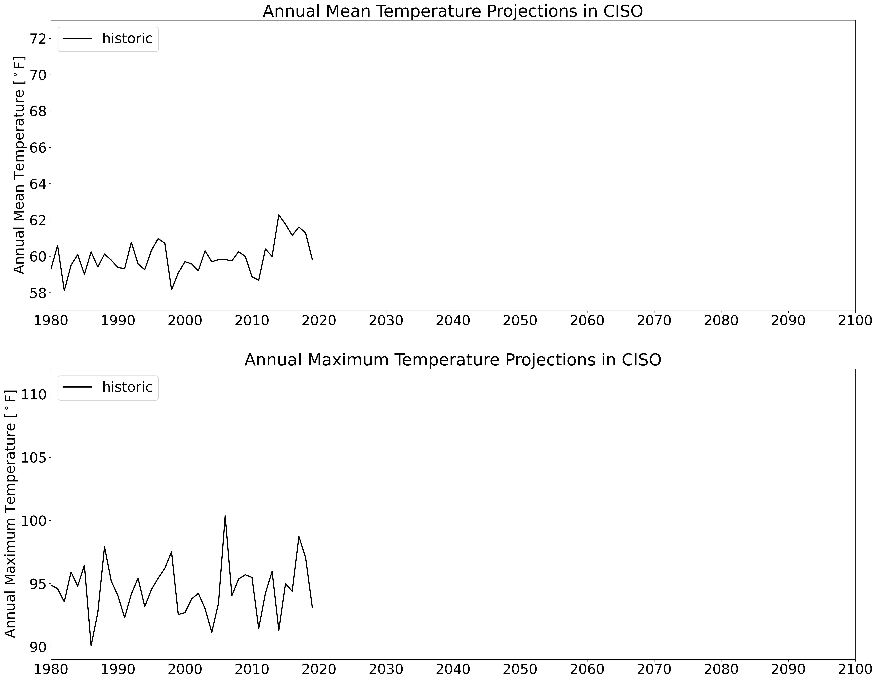
U.S. Climate Projection Dataset
Historic data reproduces observed sequence of past events (1980–2019)
Sequence is repeated twice in the future (2020–2059 and 2060–2099) with additional warming gradually applied
1/8 deg (~12 km) resolution, U.S., hourly
25 hourly and 250+ three-hourly variables
Output is first spatially-averaged by county then population-weighted to create annual 8,760-hr meteorology time series for 54 BAs across the U.S.
Hot Year
Climate data was developed with DOE Sc funding and is publicly available: https://data.msdlive.org/records/cnsy6-0y610

Slide 6
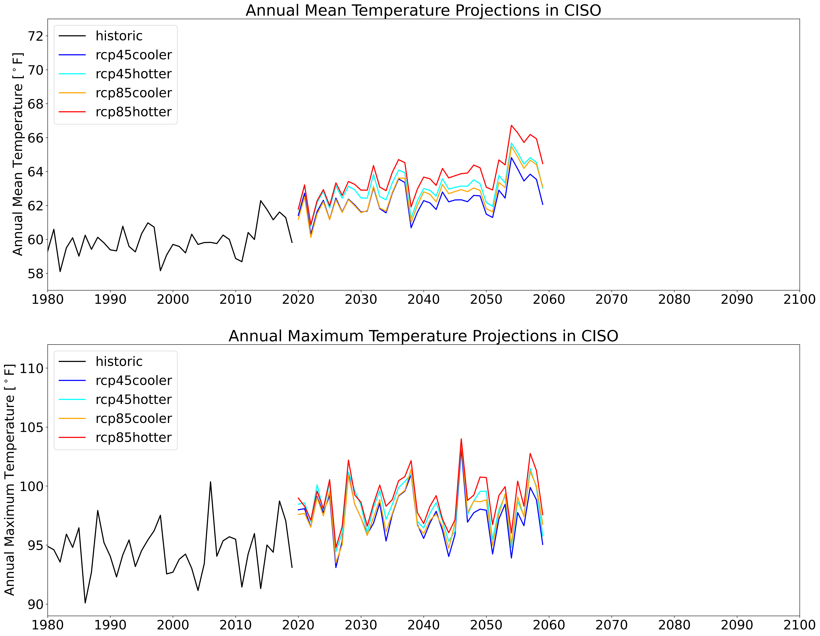
U.S. Climate Projection Dataset
Historic data reproduces observed sequence of past events (1980–2019)
Sequence is repeated twice in the future (2020–2059 and 2060–2099) with additional warming gradually applied
1/8 deg (~12 km) resolution, U.S., hourly
25 hourly and 250+ three-hourly variables
Output is first spatially-averaged by county then population-weighted to create annual 8,760-hr meteorology time series for 54 BAs across the U.S.
Hot Year
40 years
Climate data was developed with DOE Sc funding and is publicly available: https://data.msdlive.org/records/cnsy6-0y610

Slide 7
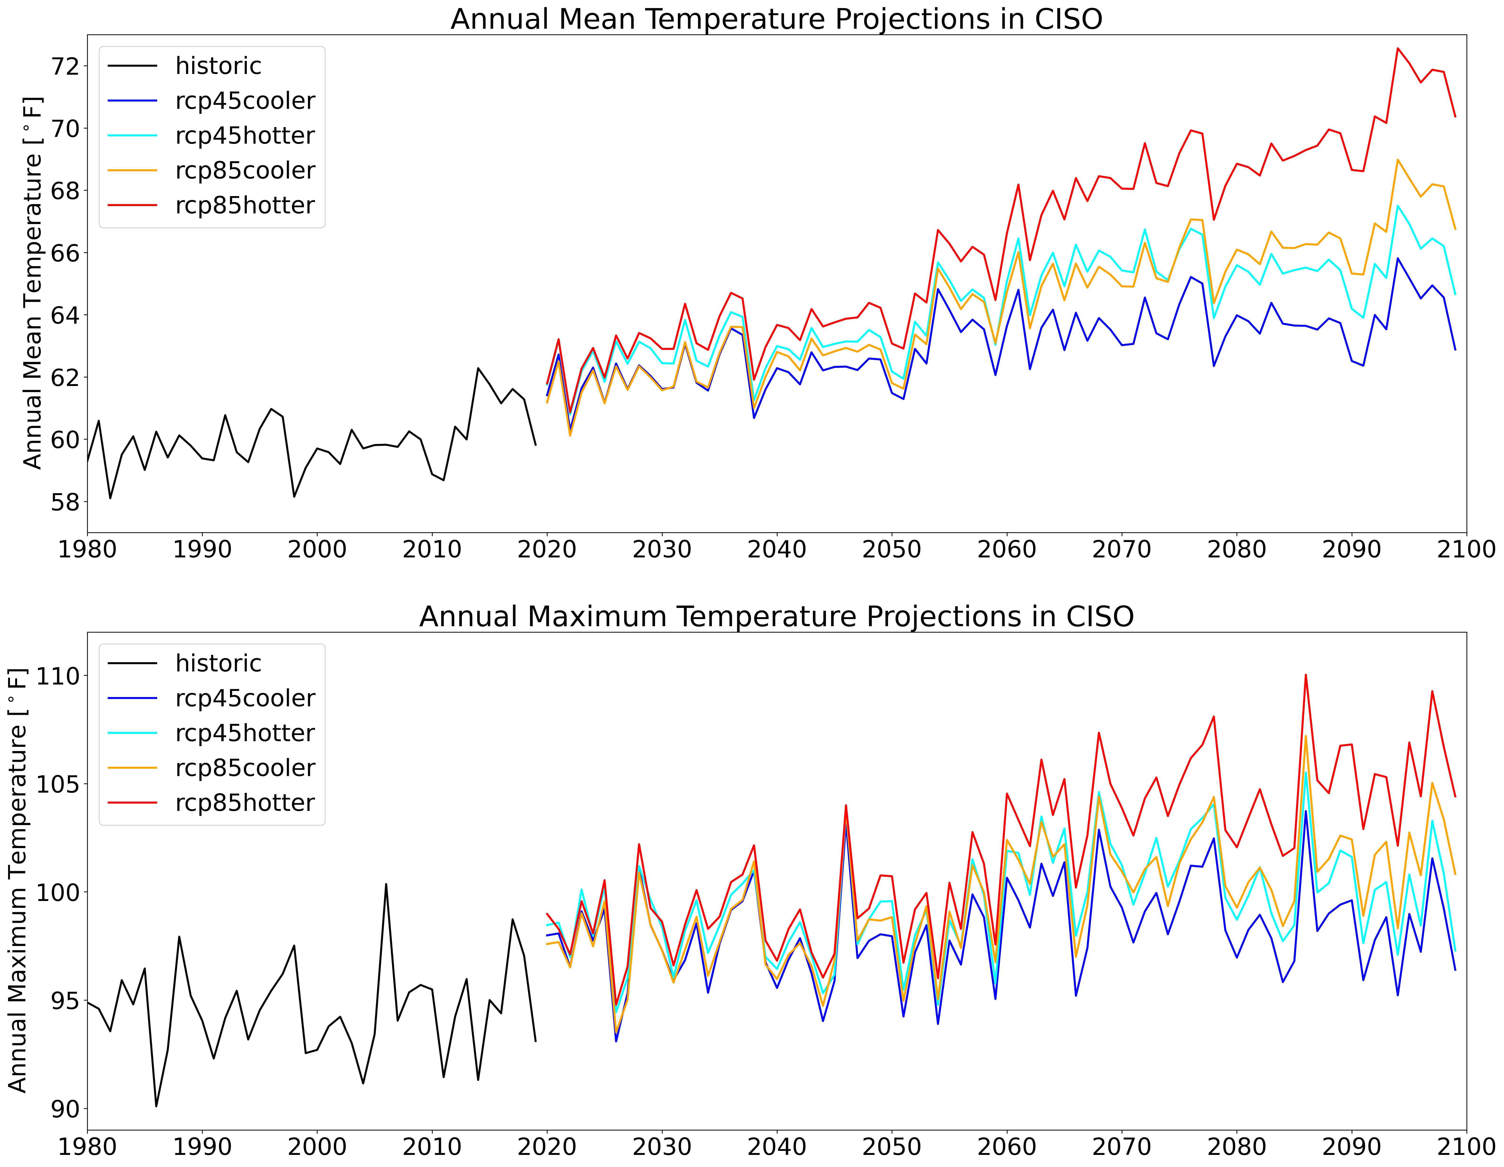
U.S. Climate Projection Dataset
Historic data reproduces observed sequence of past events (1980–2019)
Sequence is repeated twice in the future (2020–2059 and 2060–2099) with additional warming gradually applied
1/8 deg (~12 km) resolution, U.S., hourly
25 hourly and 250+ three-hourly variables
Output is first spatially-averaged by county then population-weighted to create annual 8,760-hr meteorology time series for 54 BAs across the U.S.
Hot Year
40 years
Climate data was developed with DOE Sc funding and is publicly available: https://data.msdlive.org/records/cnsy6-0y610

Slide 8
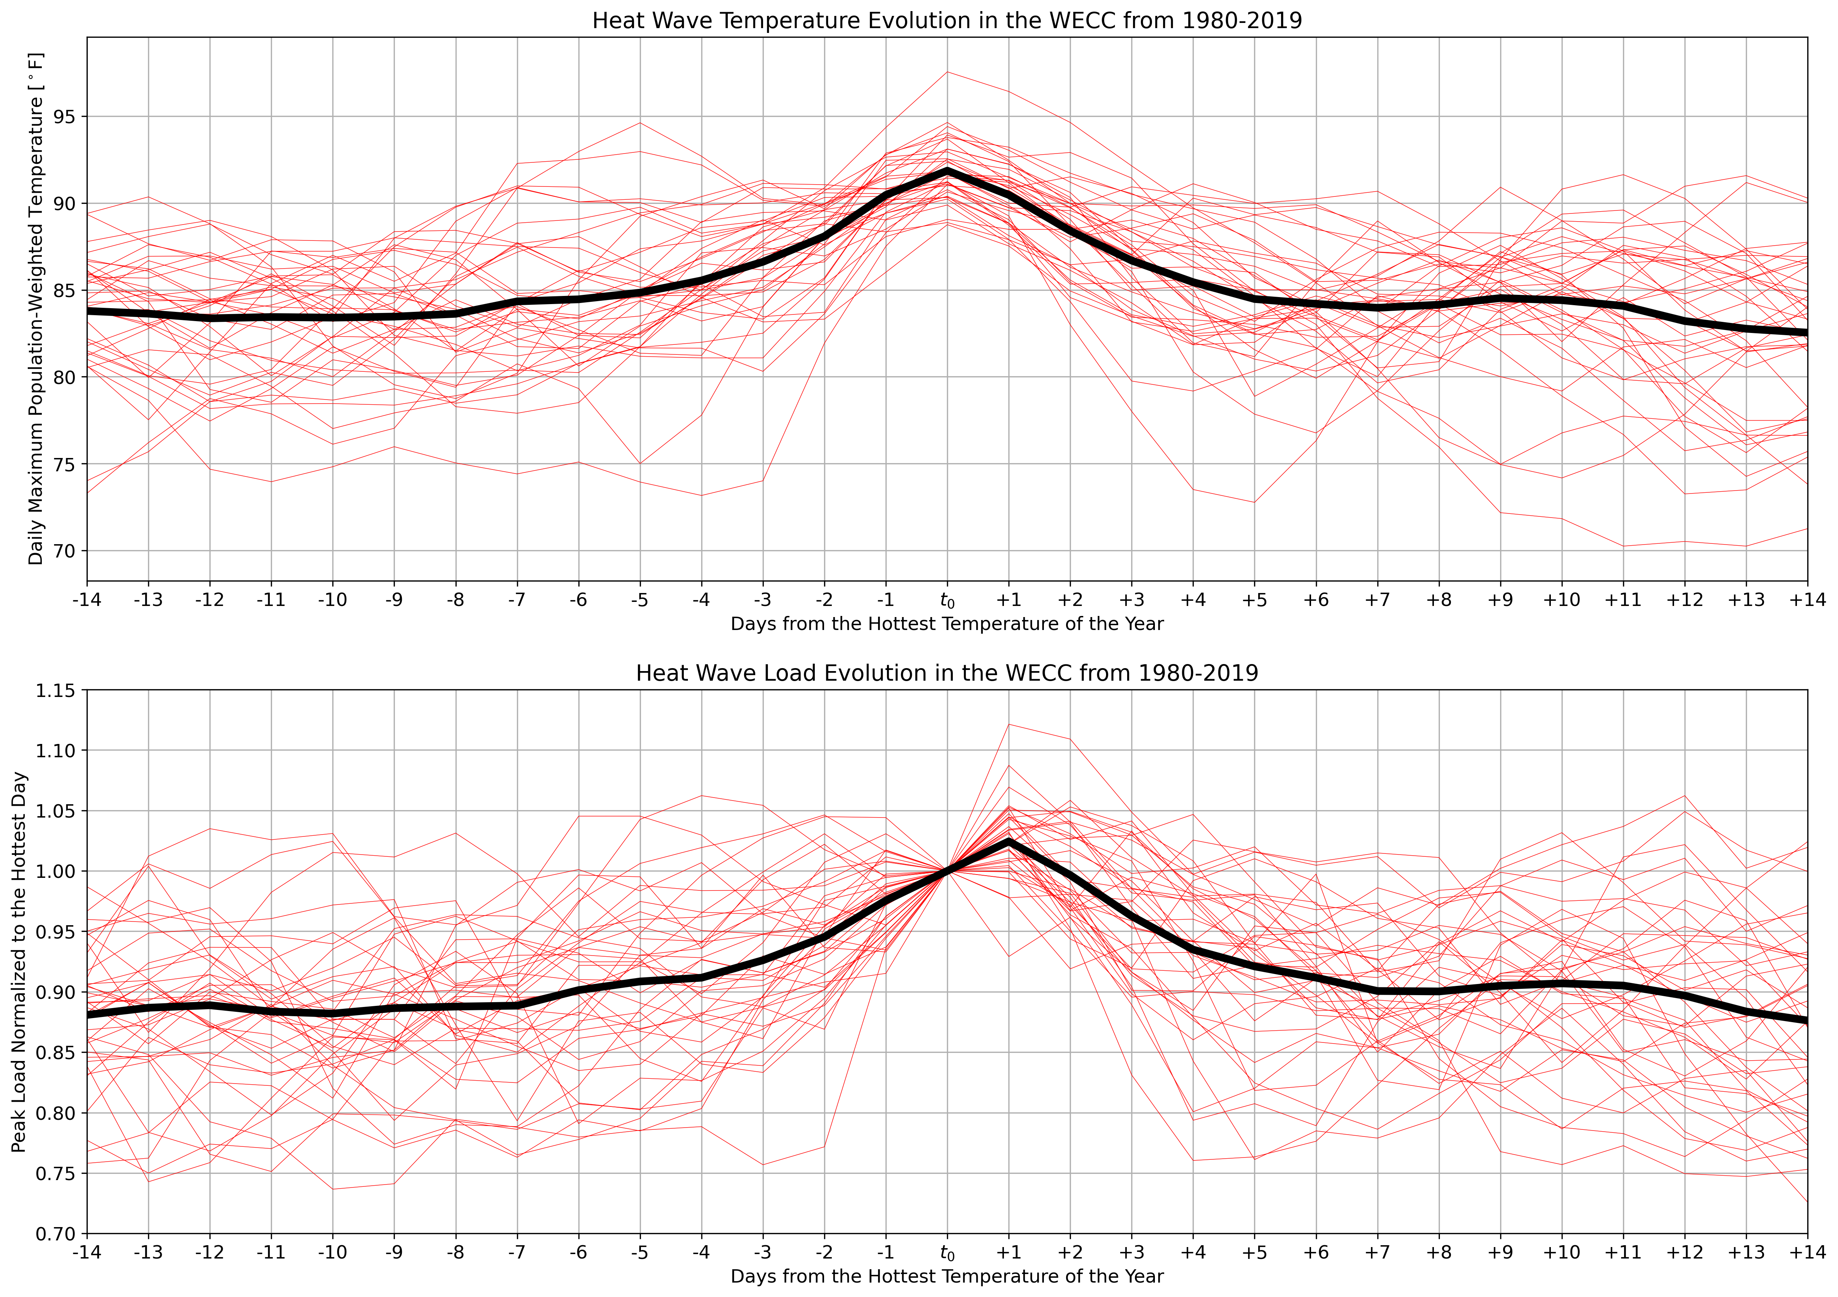
Designing Stress Tests Based on Heat Wave Dynamics
Typical heat waves last ~6-7 days and are, on average, symmetric about the maximum temperature day.
~7-day duration

Slide 9
Designing Stress Tests Based on Heat Wave Dynamics
Heat waves increase peak loads by ~10% on average compared to the background peak loads.
~7-day duration
~10% increase

Slide 10
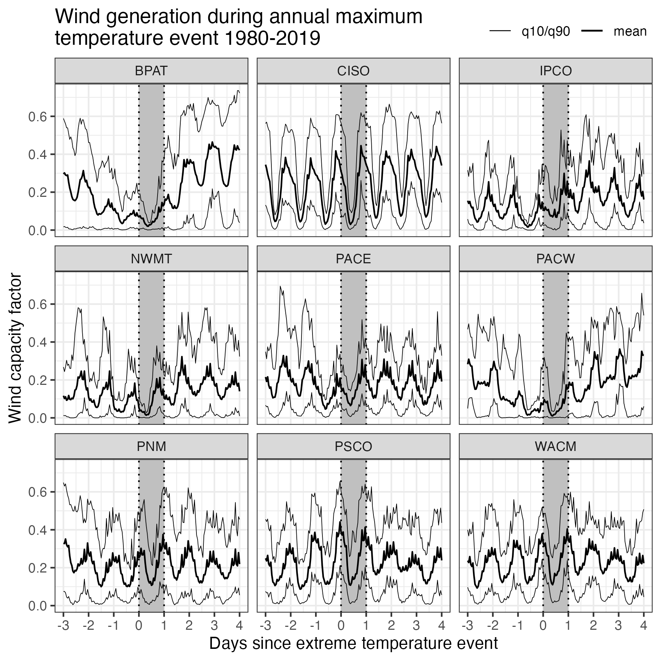
Notable Suppression of Wind Generation During Heat Waves
BAs in the Pacific Northwest (e.g., BPAT, PACW, and NWMT) show notable suppression of wind generation during heat waves.

Slide 11
Exploring Historical Heat Wave Grid Stress
https://doi.org/10.57931/2001010

Slide 12
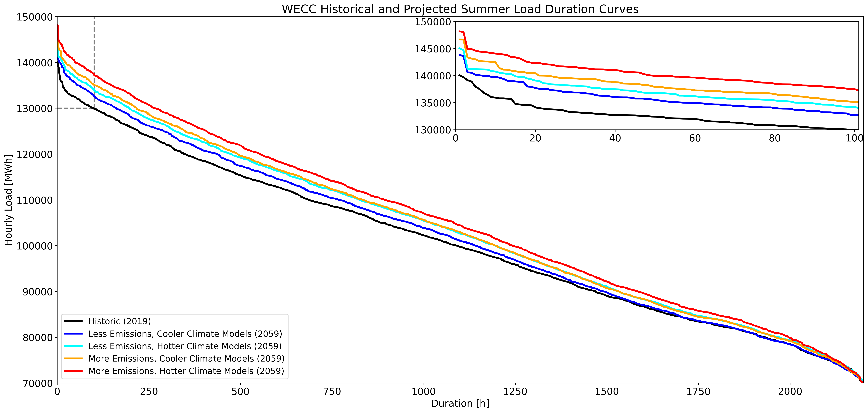
What About Future Heat Waves?
+5.9% in top-100 hourly loads due to climate change
Summer (Jun-Jul-Aug) load duration curves based on the 2019 weather year

Slide 13
Exploring Future Heat Wave Grid Stress
https://doi.org/10.57931/2001010

Slide 14
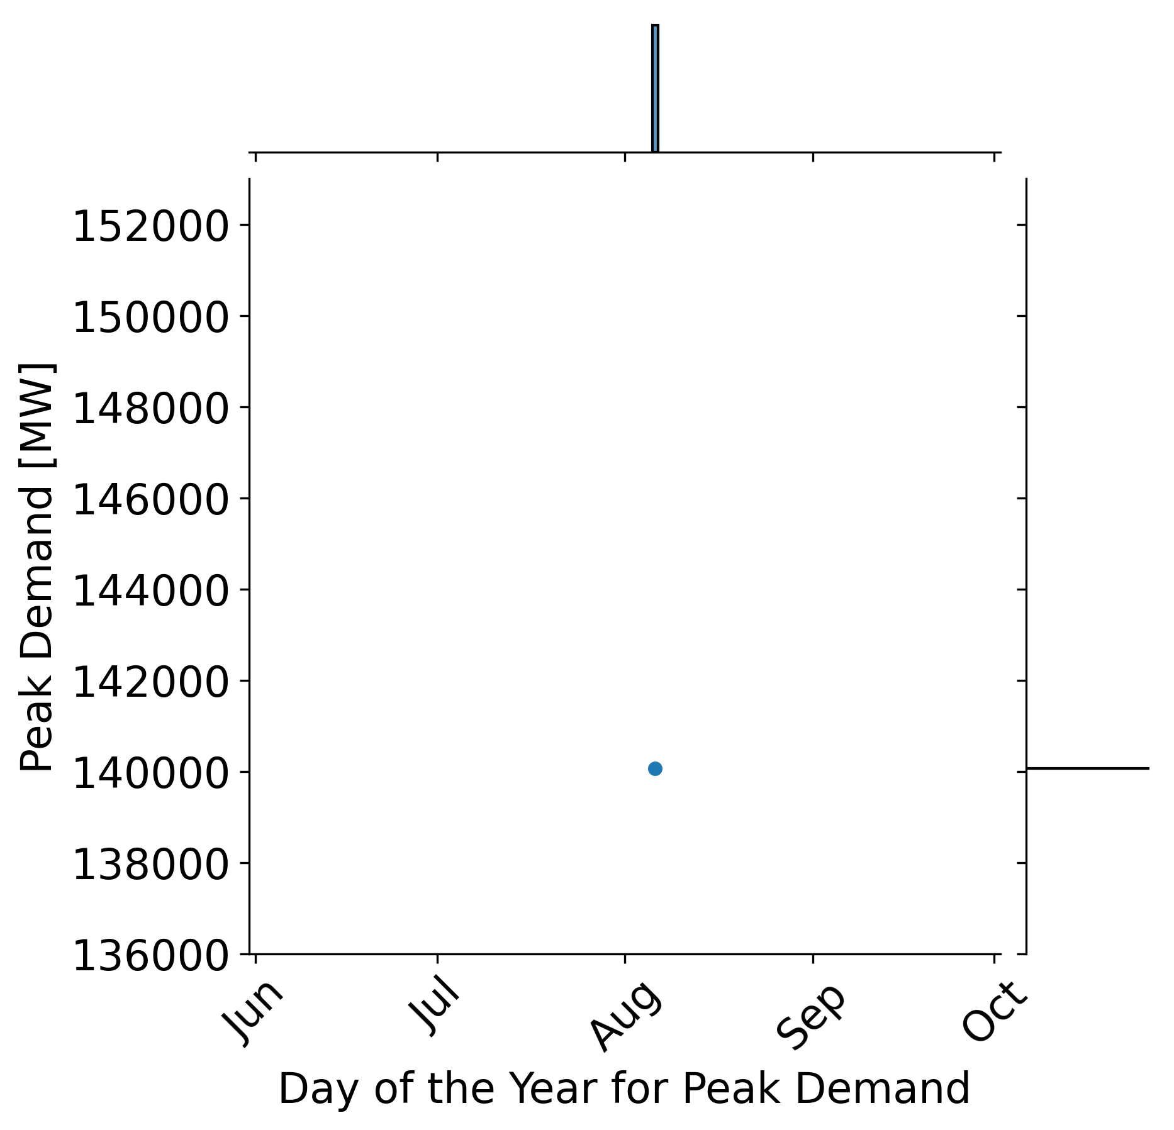
Simulating Multiple Weather Years to Explore Uncertainty
The prior example used a single weather year, but we can run many unique weather years through PNNL’s wind, load, and solar models:
All years have the same total annual energy consumption by design
Absolute magnitude and timing of peak demand varies significantly depending on the weather each year
2019 weather year

Slide 15
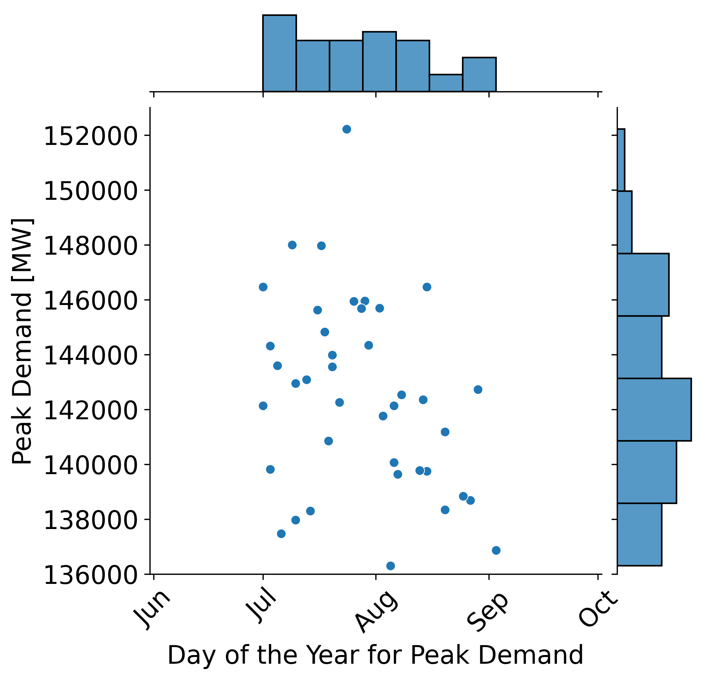
Simulating Multiple Weather Years to Explore Uncertainty
Select weather years with extreme peaks for testing resilience…
The prior example used a single weather year, but we can run many unique weather years through PNNL’s wind, load, and solar models:
All years have the same total annual energy consumption by design
Absolute magnitude and timing of peak demand varies significantly depending on the weather each year
Select weather years with late season peaks to assess reliability with low hydro…

Slide 16
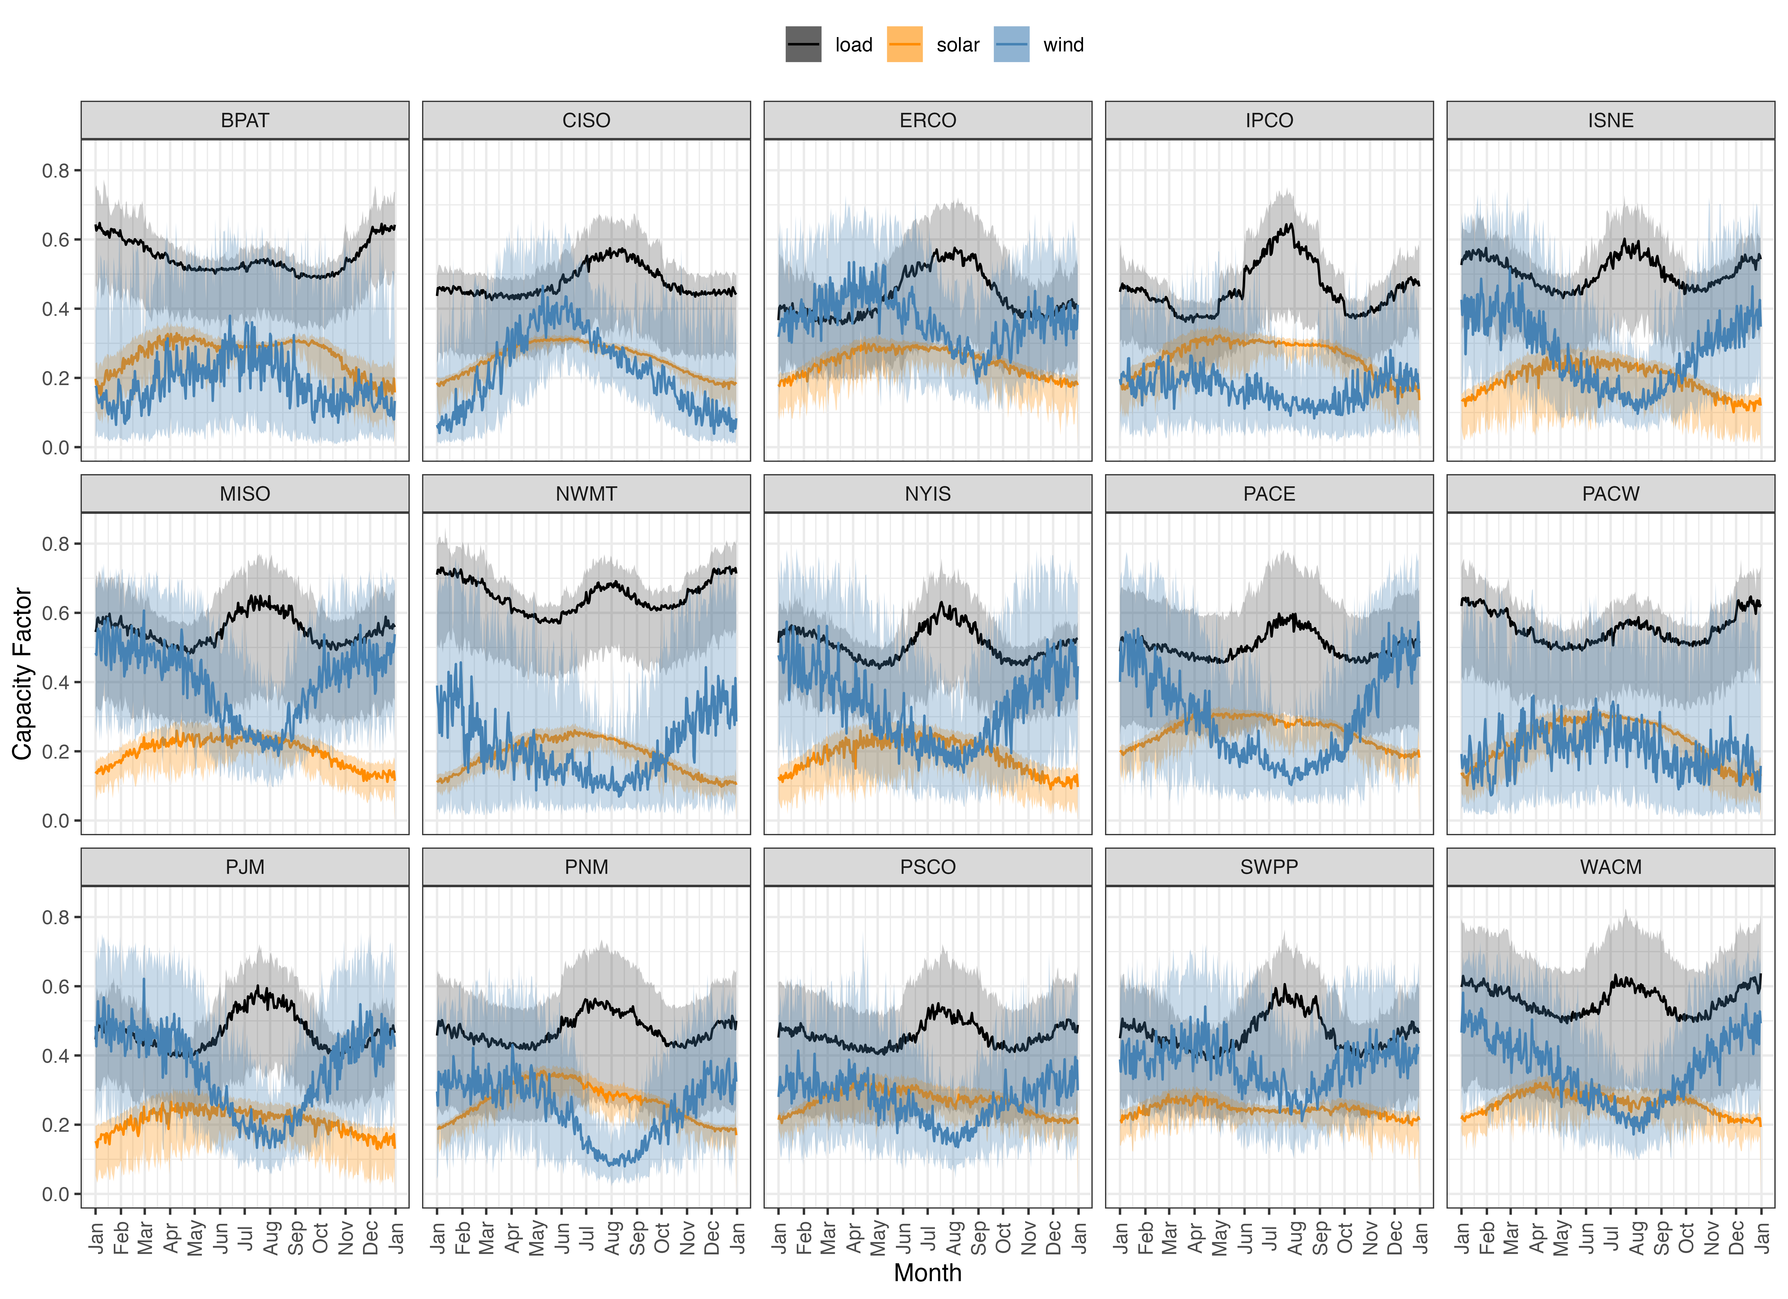
Wind Solar and Load Cycles Vary Depending on the Region and Season
1980-2019
At the seasonal time scale, there is often complementarity between wind and solar to address high load periods. For seasonal droughts, hydro, natural gas and transmission also need to be considered.
Summer high load,
low wind,
high solar
Winter
high load,
high wind,
low solar

Slide 17
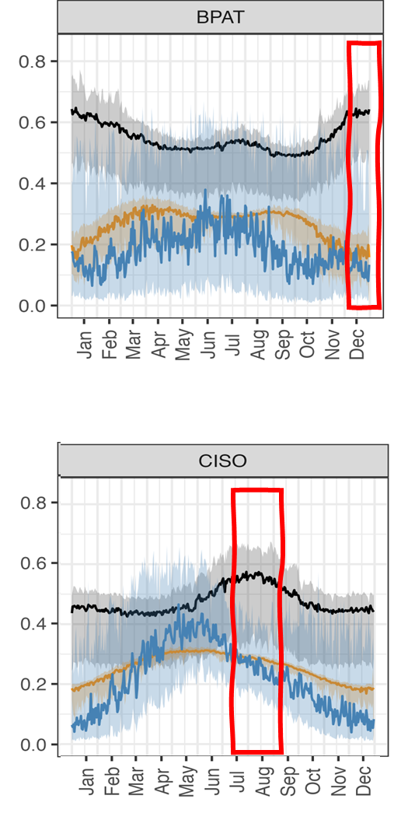
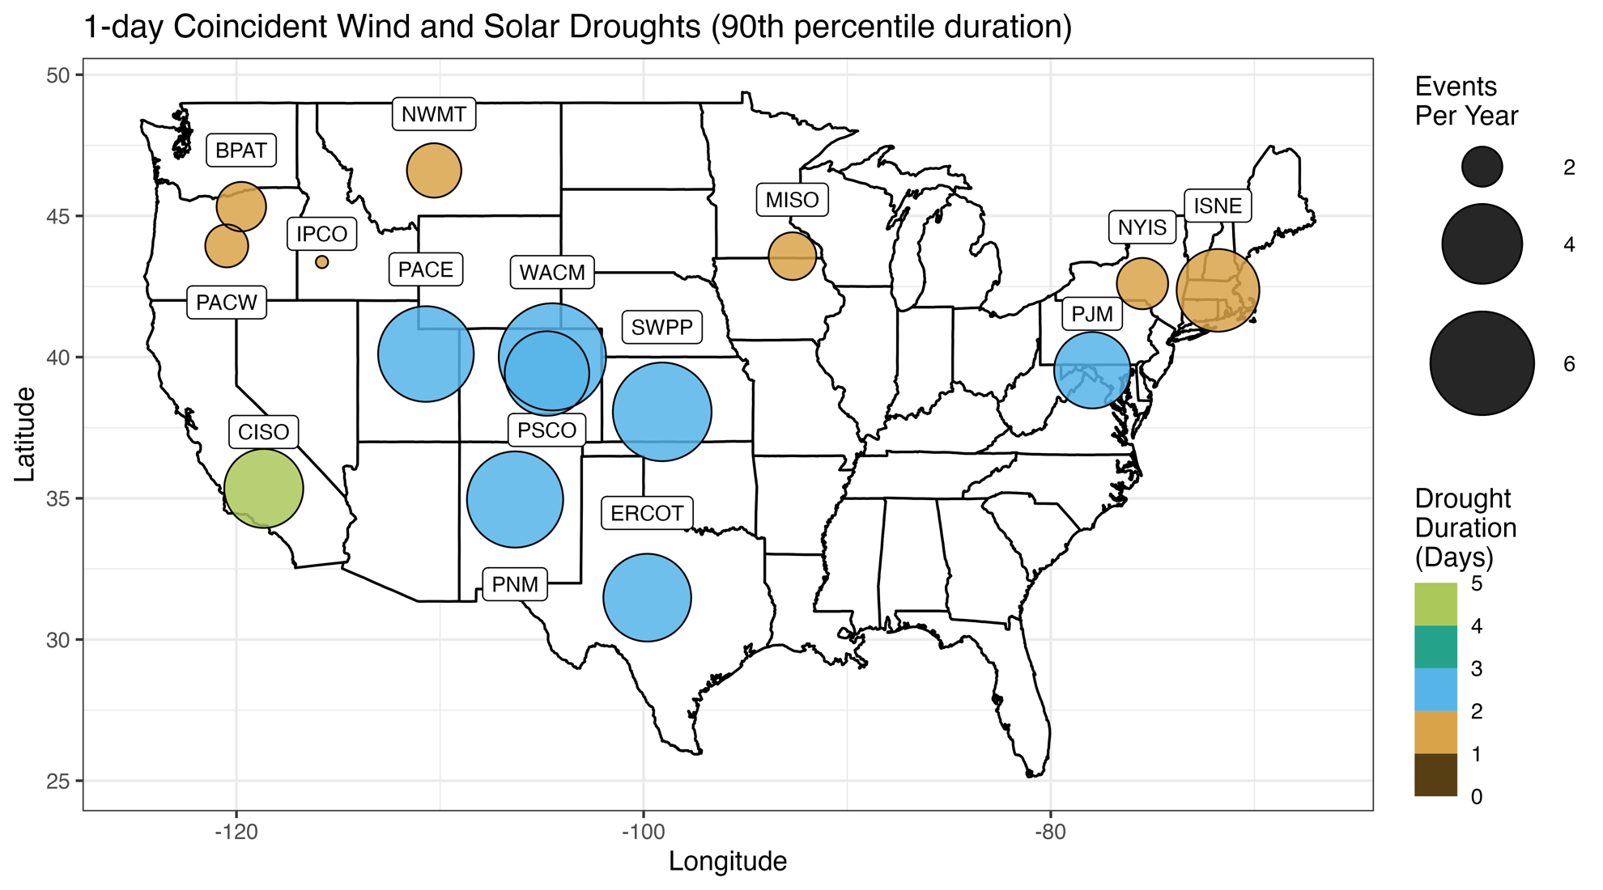
Coincident Datasets Help Identify Periods of Potential Stress
Energy droughts help understand storage and regional transmission needs and whether market mechanisms incentivize those operations.
Bracken et al. ( in revision)

Slide 18
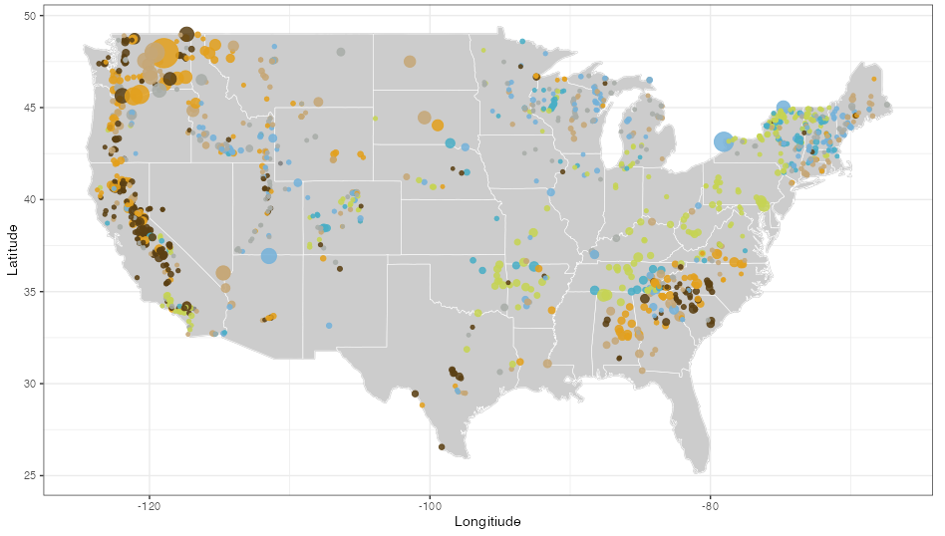
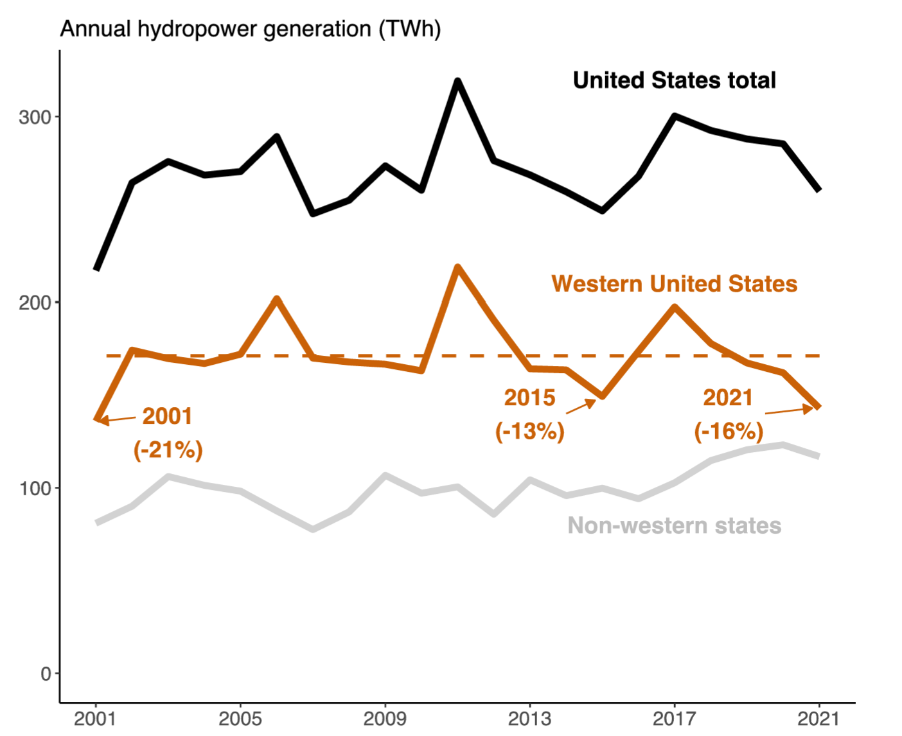
Hydropower Datasets Are Available for Input Into Power System Models
July 2015
2018
July 2018
Very high
Above normal
Normal
Below normal
Very low
Interannual variations in hydropower generation are expected and need to be considered in power system studies.
July hydropower generation by power plant. Hydropower datasets include weekly potential generation and flexibility.

Slide 19
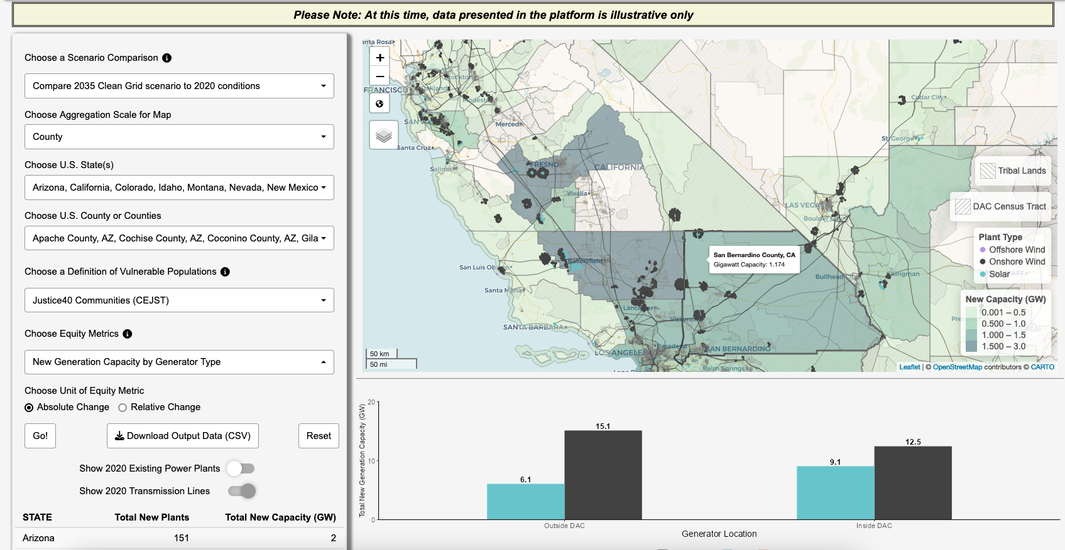
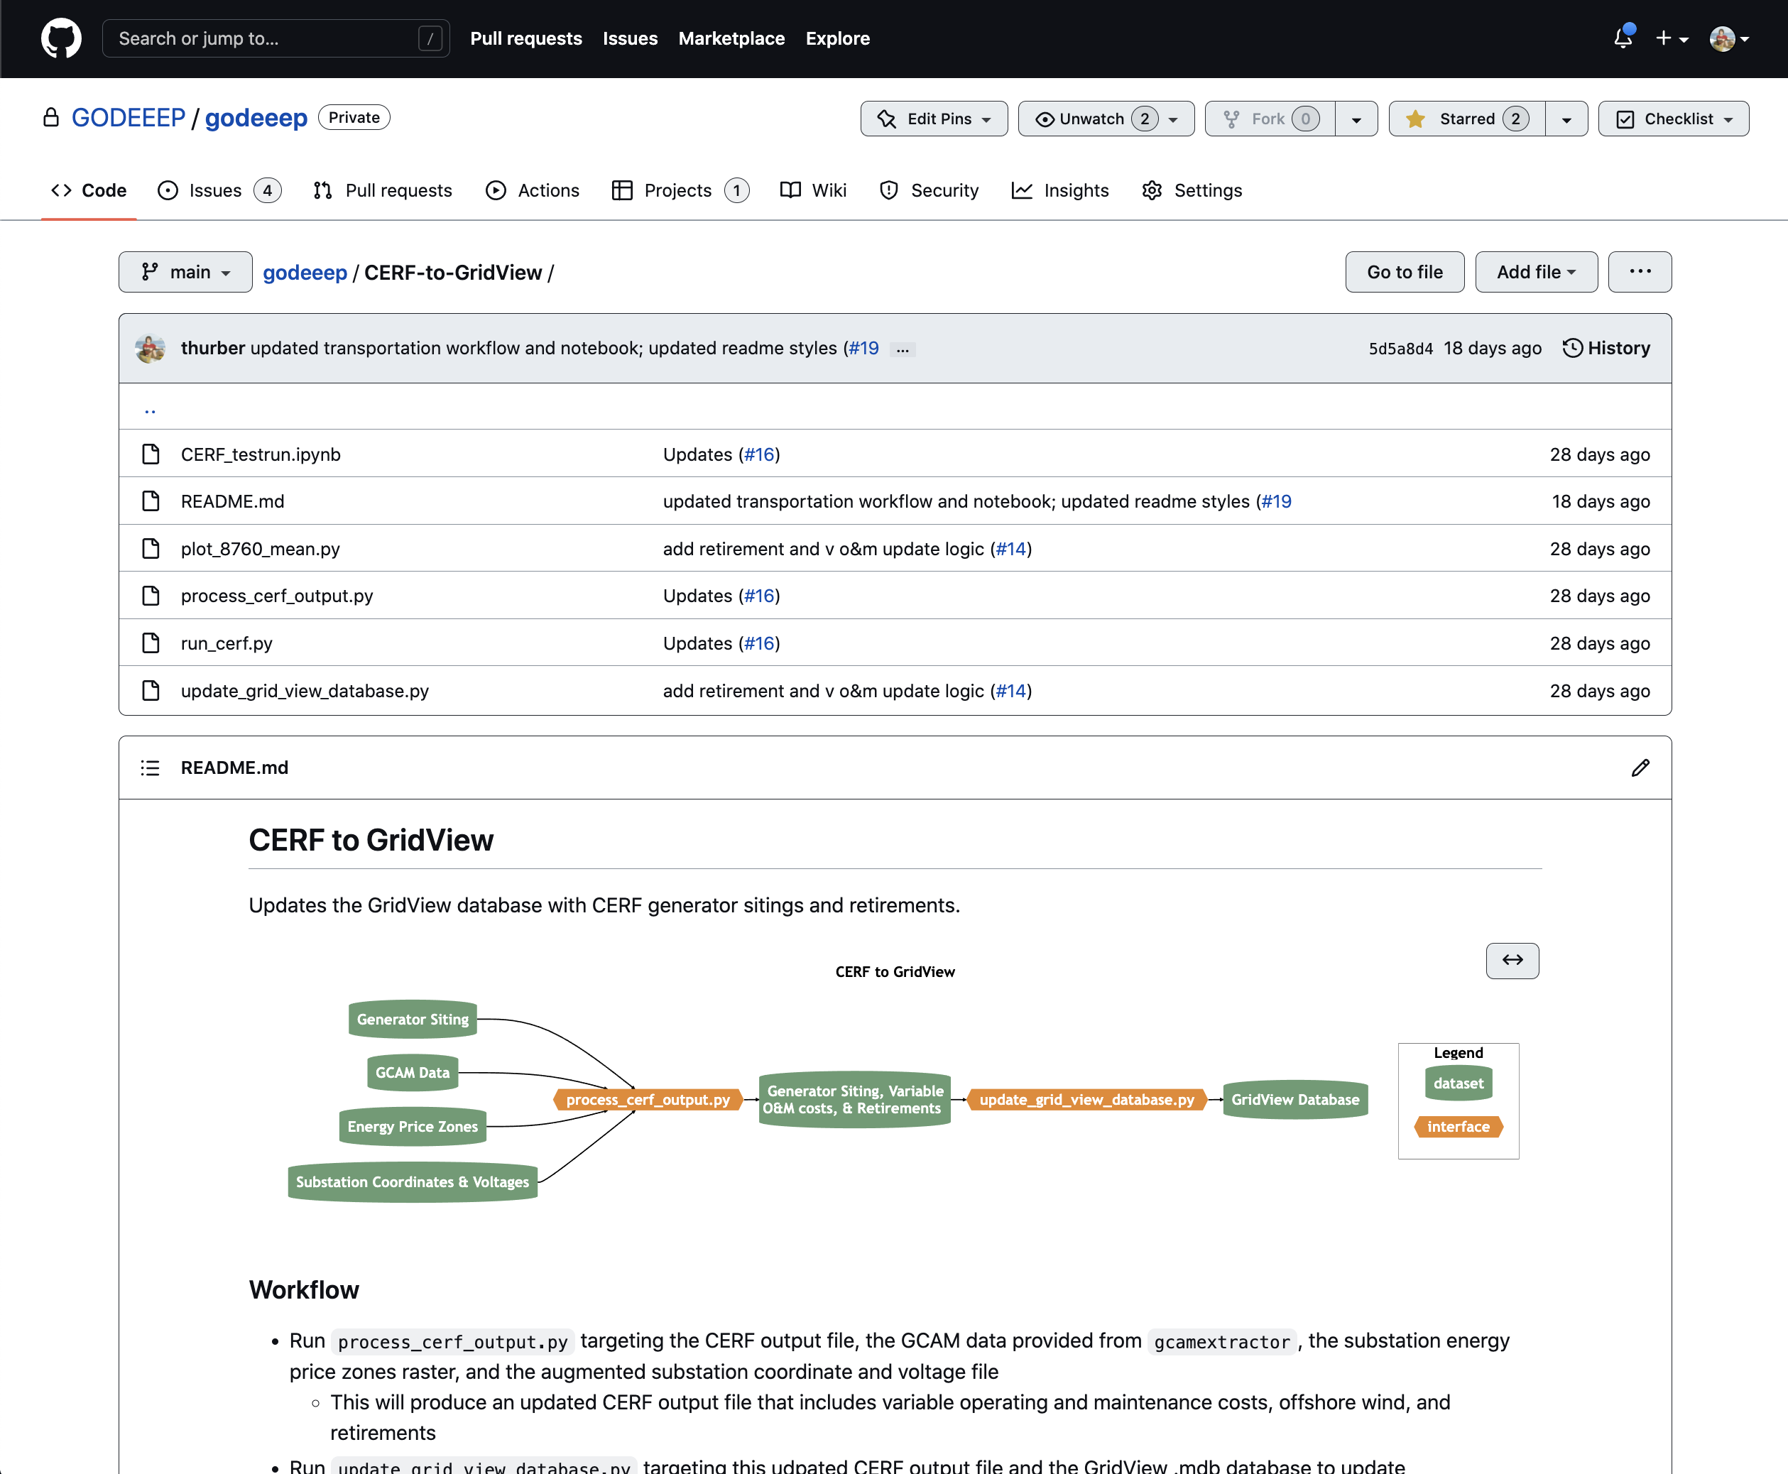
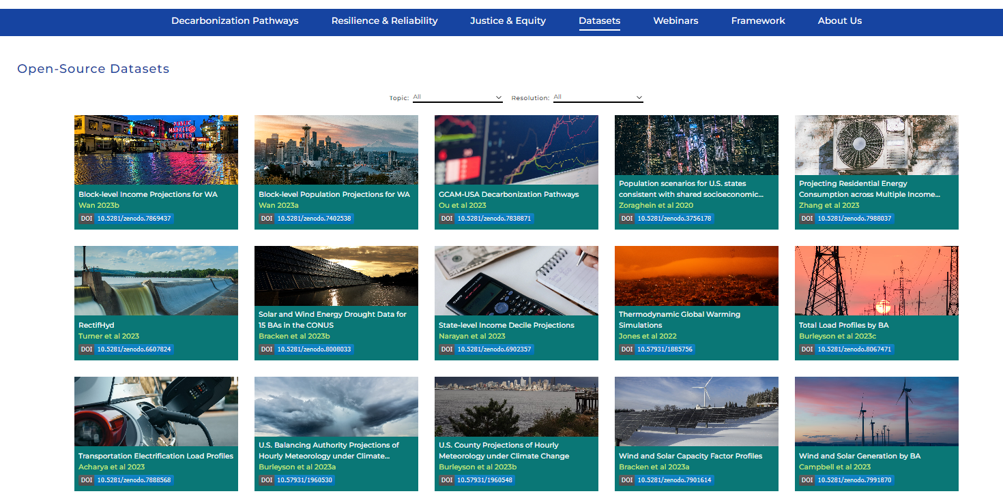
Sharing Data and Models
Open-source, vetted datasets are available in multiple formats in support of targeted questions by industry.
godeeep.pnnl.gov

Slide 20
Key Messages and Results
To assess the resilience and reliability of the bulk power system, it is critical to evaluate system performance with coincident load-wind-solar-hydro conditions and across a wide range of historical and projected weather conditions.
We are translating scientific understanding into actionable power-system relevant data and insights for use in long-term planning.
The conditions that stressed your system in the past may not be the ones that stress your system in the future.
Innovations:
Spatially- and temporally-coincident load, wind, and solar data
Capture consistent and realistic impacts on electricity supply and demand for use in stress testing projected infrastructure
Quantitative characterization of wind and solar droughts

Slide 21
Datasets, Models, and Funding
Key Datasets
Climate Forcing
Jones, A. D., Rastogi, D., Vahmani, P., Stansfield, A., Reed, K., Thurber, T., Ullrich, P., & Rice, J. S. (2022). IM3/HyperFACETS Thermodynamic Global Warming (TGW) Simulation Datasets (v1.0.0) [Data set]. MSD-LIVE Data Repository. https://doi.org/10.57931/1885756
Wind and Solar Generation
Bracken, C., Thurber, T., & Voisin, N. (2023). Hourly Wind and Solar Generation Profiles at 1/8th Degree Resolution (v1.0.0) [Data set]. Zenodo. https://doi.org/10.5281/zenodo.10214348
Key Models
Capacity Expansion Regional Feasibility (CERF): https://immm-sfa.github.io/cerf/
Grid Operations (GO): https://immm-sfa.github.io/go/
Renewable Energy Potential (reV): https://nrel.github.io/reV/
Total ELectricity Loads (TELL): https://immm-sfa.github.io/tell/
Funding
Various elements of this research were independently funded by DOE BER, DOE WPTO, and internal funding from PNNL

